Slide 1


VISUAL PRODUCT PRESENTATION
Sentinel Assure
Governance, risk, compliance and analysis in permission-controlled workspaces.
Current screens · Visual workflows · Deployment detail
Generated concept illustration
Notes:
Source: Sentinel Assure current application README, implementation documentation and configured-test-system captures. Generated scenes are illustrative, not customer deployments.
Governance, risk, compliance and analysis in permission-controlled workspaces.
Product proposal
Prepared for organisations assessing Sentinel Assure. This is a product overview and proposed implementation approach, not a signed offer or statement of completed deployment.
Edition
31 October 2026
Product scope
Sentinel Assure is a governance and analysis application. It does not provide camera monitoring, biometric identification or drone control.
Visual source: assets/products/sentinel-assure-hero.png
Generated concept illustration.

Slide 2

SENTINEL ASSURE
Executive overview
Governance, risk, compliance and local data analysis for audit and assurance teams.
The operational outcome
A traceable view of risks, controls, findings and follow-up actions.
Who uses it
Audit, risk, compliance and revenue-assurance teams
Generated illustrative scenario; not a customer deployment.
Sentinel Assure
02
Notes:
Source: Sentinel Assure current application README, implementation documentation and configured-test-system captures. Generated scenes are illustrative, not customer deployments.
Governance, risk, compliance and local data analysis for audit and assurance teams.
Intended team
Audit, risk, compliance and revenue-assurance teams
Operational outcome
A traceable view of risks, controls, findings and follow-up actions.
Implementation boundary
Governance, risk, compliance and analysis in permission-controlled workspaces. Requirements depend on the chosen host, inputs, permissions and agreed integration scope.
Decision context
The organisation retains responsibility for authorised use, staff decisions, source data and commissioning. Illustrative scenarios are examples, not customer testimonials.
Visual source: assets/products/illustrations/products-scenarios.png
Generated illustrative scenario; not a customer deployment.

Slide 3

SENTINEL ASSURE
Users and responsibilities
Clear ownership supports accountable operation.
Super administrator
Create staff accounts and grant workspace-creation or external-analysis permissions.
Workspace owner
Manage membership, assign accountability and review assurance records.
Editor
Maintain records and follow-up actions in the shared workspace.
Viewer
Read and export authorised reports without changing records.
Generated illustrative scenario; not a customer deployment.
Sentinel Assure
03
Notes:
Source: Sentinel Assure current application README, implementation documentation and configured-test-system captures. Generated scenes are illustrative, not customer deployments.
Clear ownership supports accountable operation.
Super administrator
Create staff accounts and grant workspace-creation or external-analysis permissions. Business-record access still requires ownership or sharing.
Workspace owner
Manage membership, assign accountability and review assurance records.
Editor
Maintain records and follow-up actions in the shared workspace.
Viewer
Read and export authorised reports without changing records.
Visual source: assets/products/illustrations/about-scenarios.png
Generated illustrative scenario; not a customer deployment.

Slide 4
SENTINEL ASSURE
Operational workflow
The product follows its own recorded workflow.
01
02
03
04
Authorised source
Review the evidence
Assign an owner
Follow up and report
Stage 1
Stage 2
Stage 3
Create a workspace and grant the right access.
Record the risks, controls and assurance work, or connect an authorised source.
Analyse the evidence, assign follow-up actions and export a reviewable report.
Sentinel Assure
04
Notes:
Source: Sentinel Assure current application README, implementation documentation and configured-test-system captures. Generated scenes are illustrative, not customer deployments.
The product follows its own recorded workflow.
Stage 1
Create a workspace and grant the right access.
Stage 2
Record the risks, controls and assurance work, or connect an authorised source.
Stage 3
Analyse the evidence, assign follow-up actions and export a reviewable report.

Slide 5
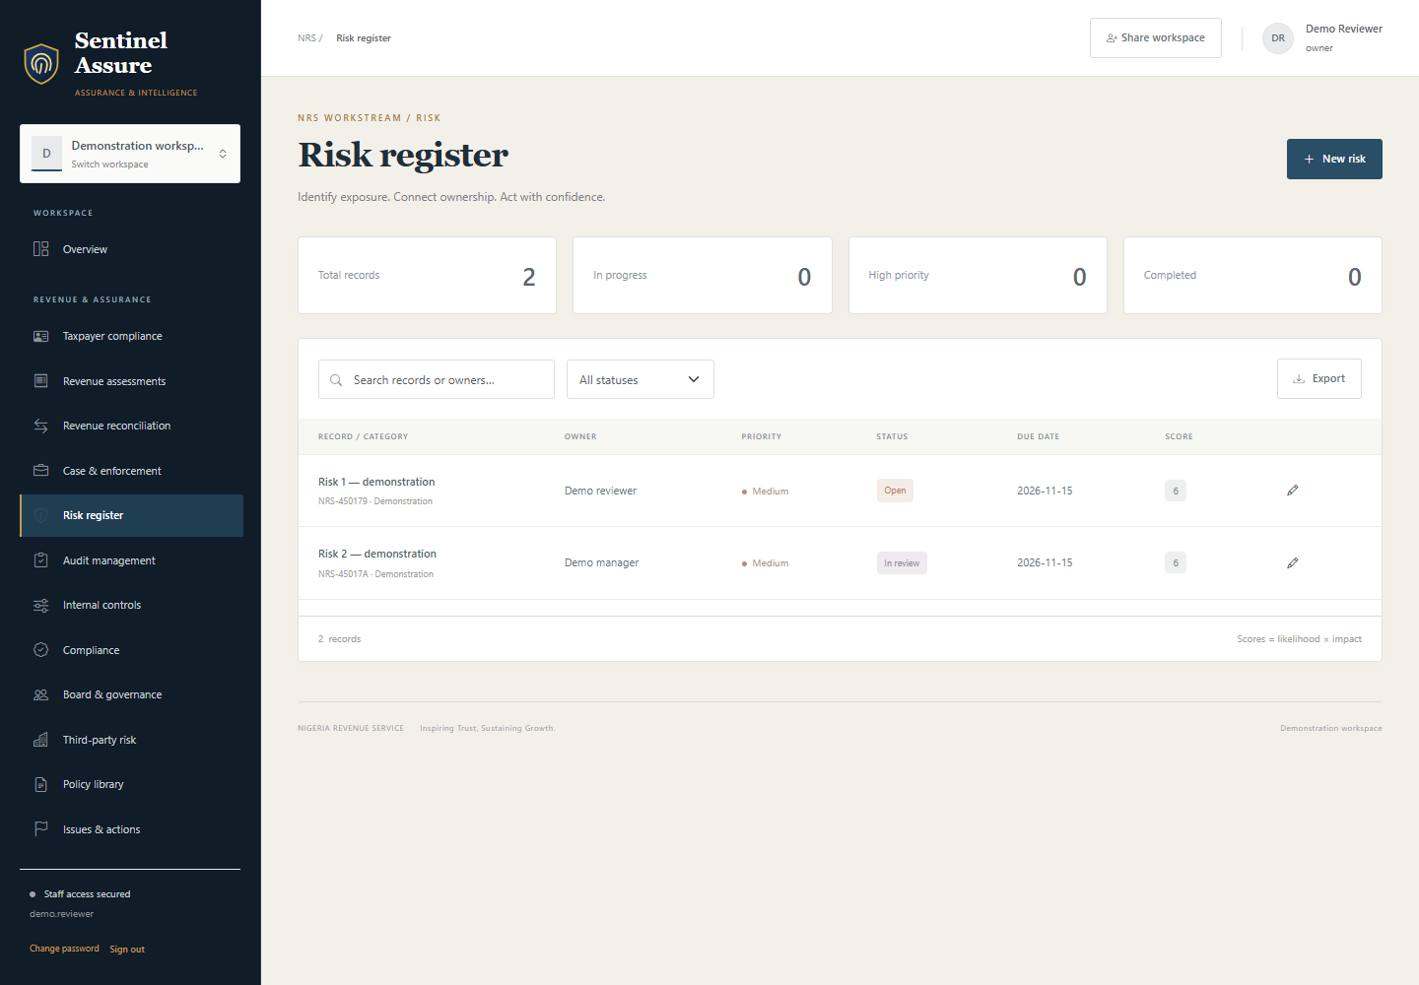
SENTINEL ASSURE
Accountable registers
Track owners, status, priority, deadlines and evidence references for risks, audits, controls, compliance obligations and remediation. Revenue-assurance fields support the configured deployment.
1
Risk exposure uses recorded likelihood and impact.
2
Remediation actions retain owners and due dates.
3
Amounts under review are not independently verified collections.
Current application interface captured from the configured test system.
Sentinel Assure
05
Notes:
Source: Sentinel Assure current application README, implementation documentation and configured-test-system captures. Generated scenes are illustrative, not customer deployments.
Track owners, status, priority, deadlines and evidence references for risks, audits, controls, compliance obligations and remediation. Revenue-assurance fields support the configured deployment.
Operating approach
Keep the source evidence and responsible officer together. Review overdue items and record the outcome before producing the final report.
What the team reviews
Risk exposure uses recorded likelihood and impact.
Remediation actions retain owners and due dates.
Amounts under review are not independently verified collections.
Acceptance evidence
Demonstrate this workflow using representative permitted inputs. Record the expected result, actual result, responsible reviewer and any remaining conditions before production approval.
Visual source: assets/products/screens/assure-risk-register.png
Current application interface captured from the configured test system.

Slide 6
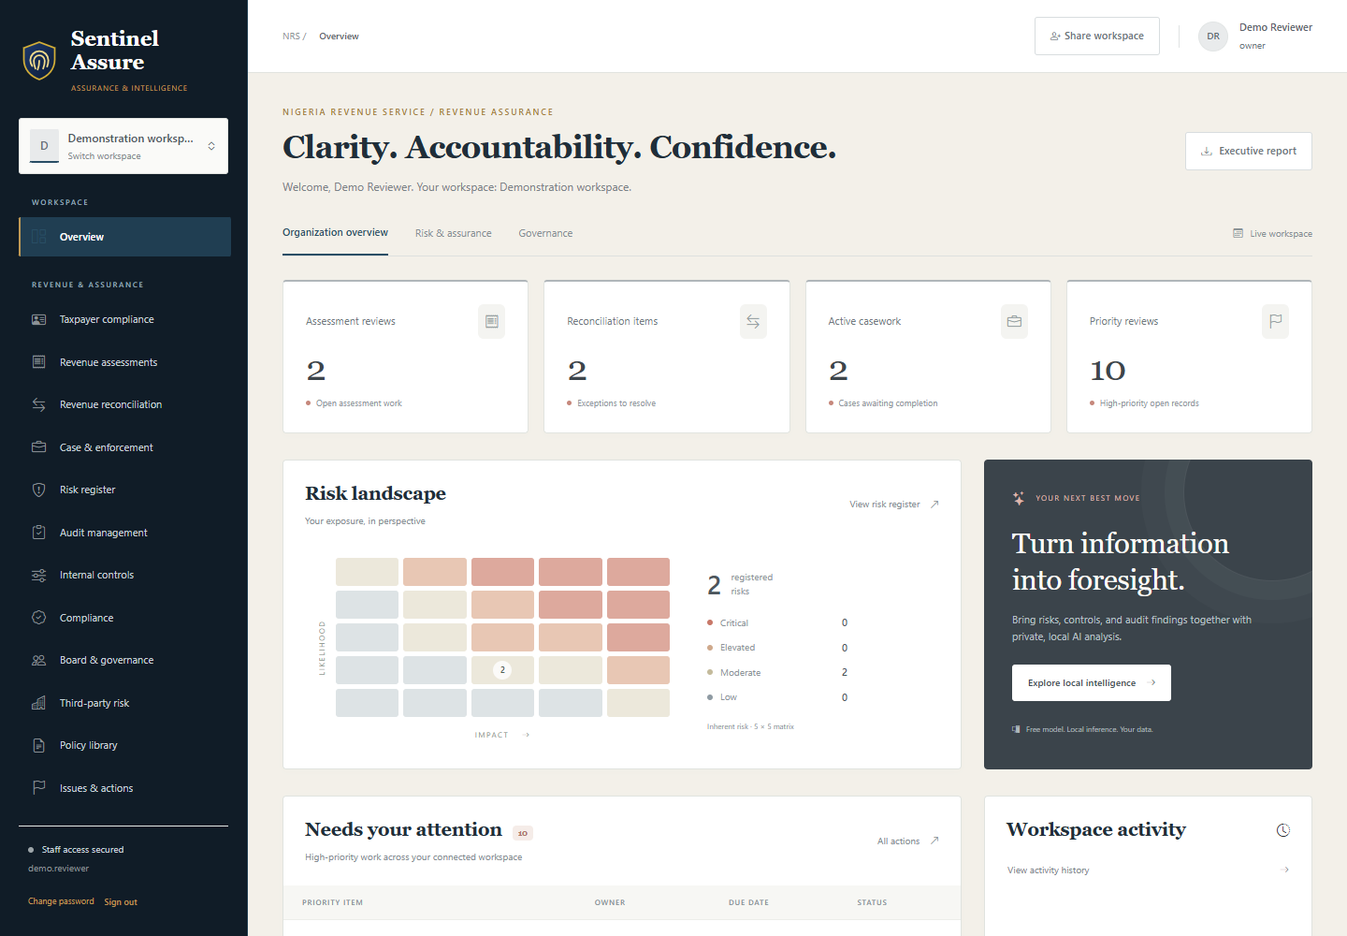
SENTINEL ASSURE
Workspace privacy
Owners share each workspace with the appropriate Viewer or Editor access. Staff administration does not bypass this business-record boundary.
1
Grant ownership or explicit membership.
2
Review access when responsibilities change.
3
Revoke membership when the engagement ends.
Current application interface captured from the configured test system.
Sentinel Assure
06
Notes:
Source: Sentinel Assure current application README, implementation documentation and configured-test-system captures. Generated scenes are illustrative, not customer deployments.
Owners share each workspace with the appropriate Viewer or Editor access. Staff administration does not bypass this business-record boundary.
Operating approach
Workspace selection survives restarts. Server-side checks prevent stale tabs from exporting another workspace accidentally.
What the team reviews
Grant ownership or explicit membership.
Review access when responsibilities change.
Revoke membership when the engagement ends.
Acceptance evidence
Demonstrate this workflow using representative permitted inputs. Record the expected result, actual result, responsible reviewer and any remaining conditions before production approval.
Visual source: assets/products/screens/assure-overview.png
Current application interface captured from the configured test system.

Slide 7
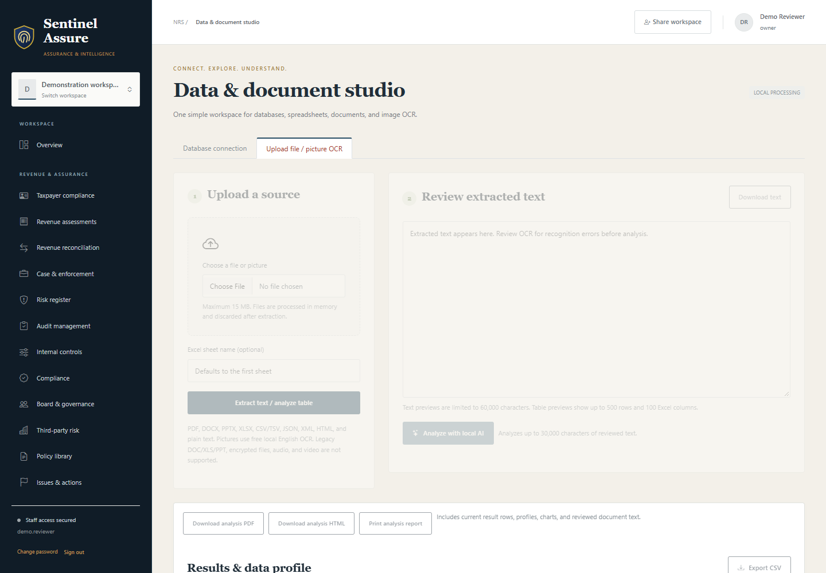
SENTINEL ASSURE
Document analysis
The studio extracts supported spreadsheets, text, Office files, PDFs and common images. Image OCR uses local Tesseract resources.
1
Use supported formats and bounded samples.
2
Check extracted text against the original document.
3
Treat sample statistics as sample statistics.
Current application interface captured from the configured test system.
Sentinel Assure
07
Notes:
Source: Sentinel Assure current application README, implementation documentation and configured-test-system captures. Generated scenes are illustrative, not customer deployments.
The studio extracts supported spreadsheets, text, Office files, PDFs and common images. Image OCR uses local Tesseract resources.
Operating approach
Review extraction quality and the documented size limits before interpreting text or statistics. A poor scan can change the apparent evidence.
What the team reviews
Use supported formats and bounded samples.
Check extracted text against the original document.
Treat sample statistics as sample statistics.
Acceptance evidence
Demonstrate this workflow using representative permitted inputs. Record the expected result, actual result, responsible reviewer and any remaining conditions before production approval.
Visual source: assets/products/screens/assure-documents.png
Current application interface captured from the configured test system.

Slide 8
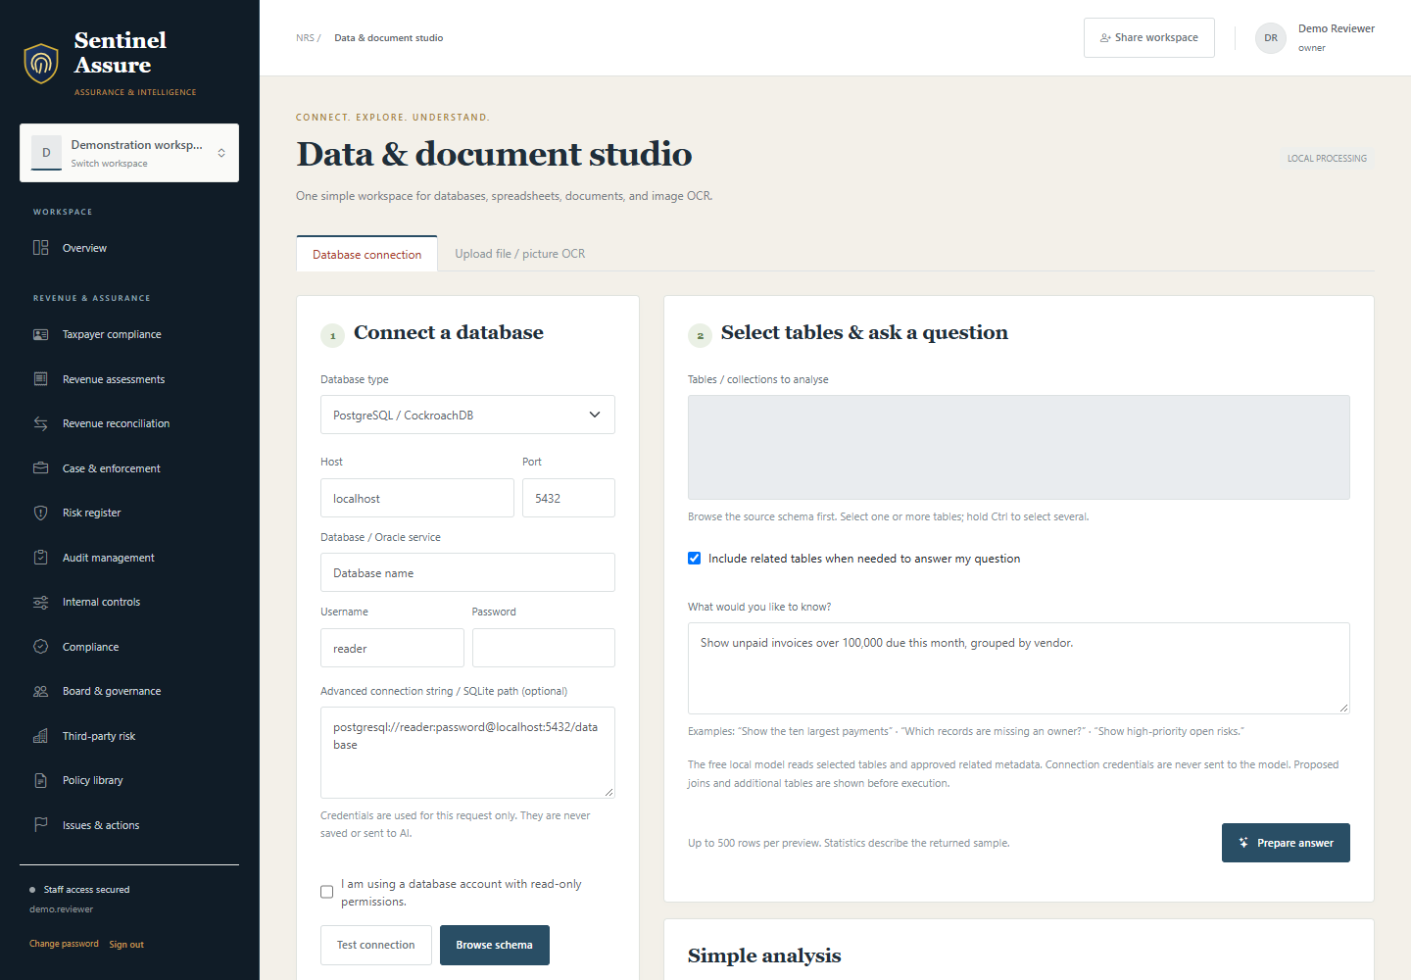
SENTINEL ASSURE
Reviewed data queries
Permitted staff can browse a bounded source schema and prepare a question using the configured database adapters.
1
Review inferred relationships and query intent.
2
Keep credentials out of model prompts.
3
Test the actual database version and dialect.
Current application interface captured from the configured test system.
Sentinel Assure
08
Notes:
Source: Sentinel Assure current application README, implementation documentation and configured-test-system captures. Generated scenes are illustrative, not customer deployments.
Permitted staff can browse a bounded source schema and prepare a question using the configured database adapters.
Operating approach
Staff review the proposed query before execution. Read-only source grants remain the essential data boundary, even where query validation is available.
What the team reviews
Review inferred relationships and query intent.
Keep credentials out of model prompts.
Test the actual database version and dialect.
Acceptance evidence
Demonstrate this workflow using representative permitted inputs. Record the expected result, actual result, responsible reviewer and any remaining conditions before production approval.
Visual source: assets/products/screens/assure-data-studio.png
Current application interface captured from the configured test system.

Slide 9
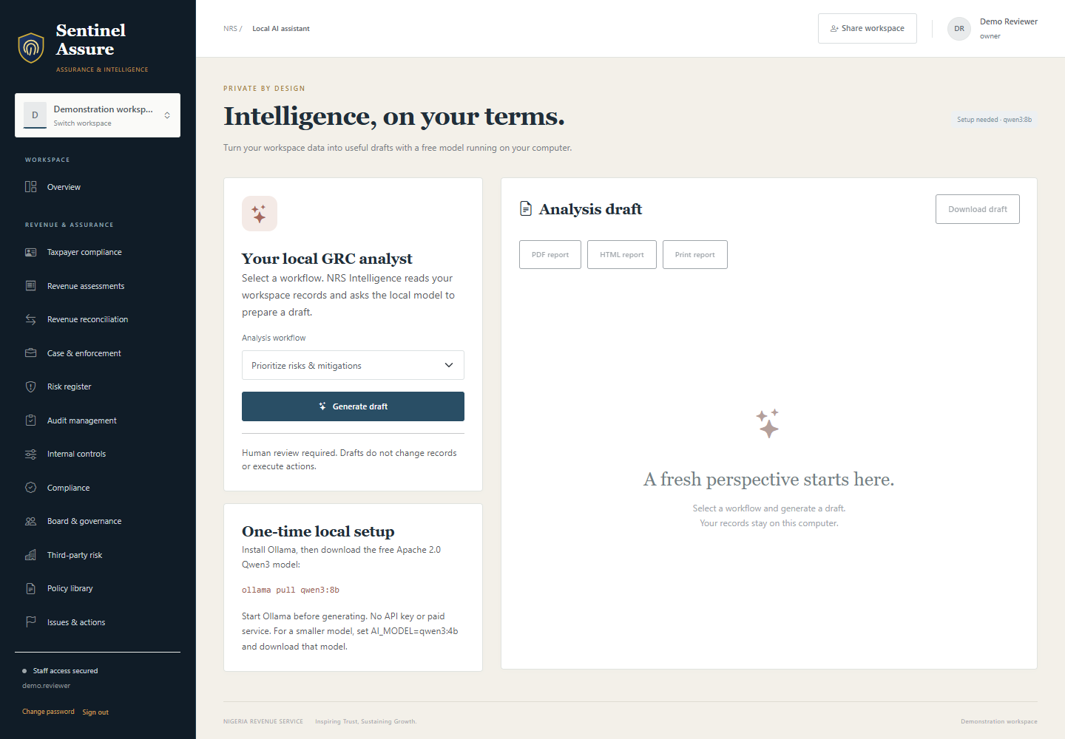
SENTINEL ASSURE
Local AI assistance
Configured local Ollama models support query planning and draft observations. The resource manager supports approved model downloads.
1
Choose a model that fits the available host.
2
Retain source context for review.
3
Confirm local resources before analysis.
Current application interface captured from the configured test system.
Sentinel Assure
09
Notes:
Source: Sentinel Assure current application README, implementation documentation and configured-test-system captures. Generated scenes are illustrative, not customer deployments.
Configured local Ollama models support query planning and draft observations. The resource manager supports approved model downloads.
Operating approach
The model does not establish a liability, approve enforcement or change source records. Staff retain responsibility for conclusions and source review.
What the team reviews
Choose a model that fits the available host.
Retain source context for review.
Confirm local resources before analysis.
Acceptance evidence
Demonstrate this workflow using representative permitted inputs. Record the expected result, actual result, responsible reviewer and any remaining conditions before production approval.
Visual source: assets/products/screens/assure-assistant.png
Current application interface captured from the configured test system.

Slide 10
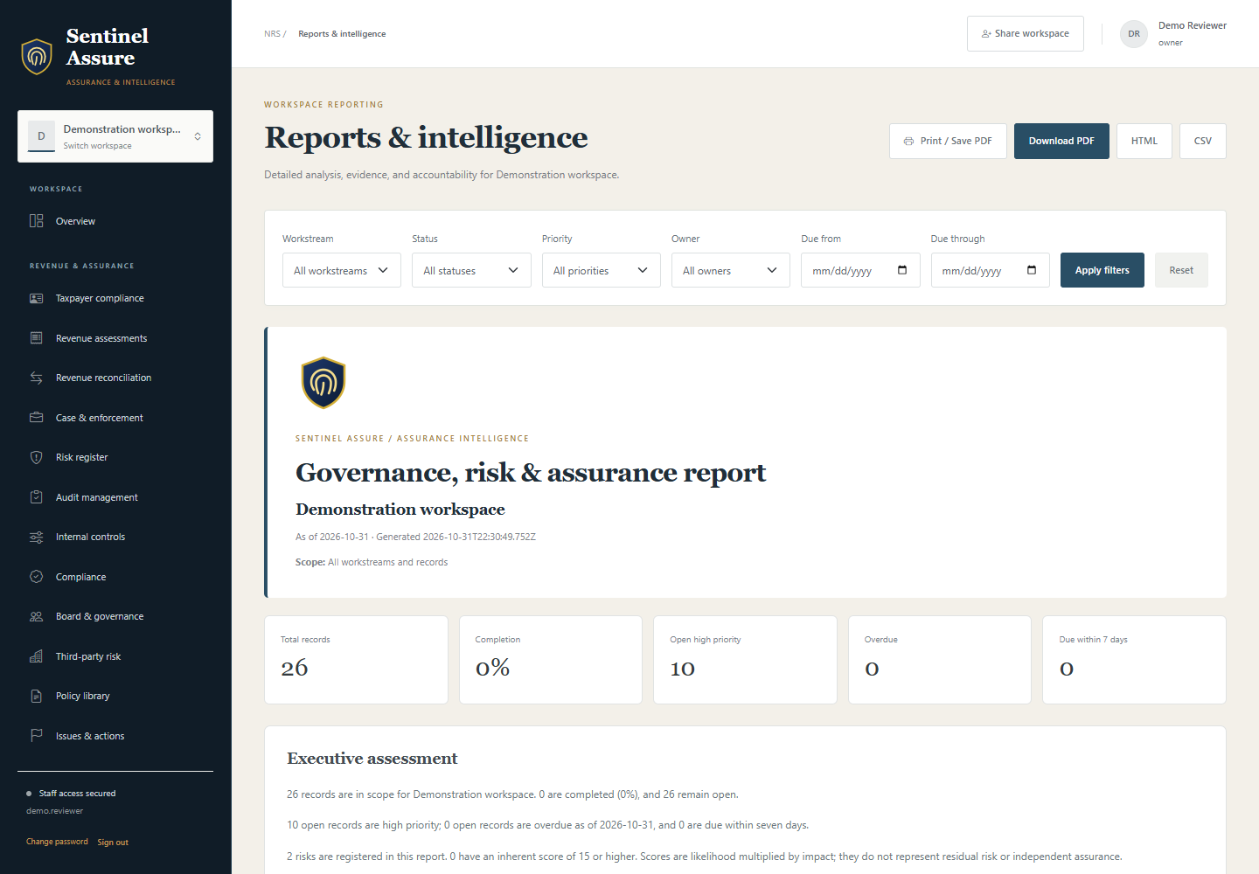
SENTINEL ASSURE
Reports and follow-up
Reports show findings, coverage, workload, deadlines and underlying record references. Supported exports include PDF, HTML and CSV.
1
Filter by workstream, owner and due dates.
2
Use protected CSV exports for spreadsheets.
3
Review overlapping amounts before summing.
Current application interface captured from the configured test system.
Sentinel Assure
10
Notes:
Source: Sentinel Assure current application README, implementation documentation and configured-test-system captures. Generated scenes are illustrative, not customer deployments.
Reports show findings, coverage, workload, deadlines and underlying record references. Supported exports include PDF, HTML and CSV.
Operating approach
Charts reflect entered records and schedules. Report readers need the workspace, filters and coverage to interpret the result.
What the team reviews
Filter by workstream, owner and due dates.
Use protected CSV exports for spreadsheets.
Review overlapping amounts before summing.
Acceptance evidence
Demonstrate this workflow using representative permitted inputs. Record the expected result, actual result, responsible reviewer and any remaining conditions before production approval.
Visual source: assets/products/screens/assure-reporting.png
Current application interface captured from the configured test system.

Slide 11
SENTINEL ASSURE
Architecture and information flow
Components and responsibilities for this product.
MongoDB
Staff browser
Application service
Analysis resources
Product-specific information flow
Sentinel Assure
11
Notes:
Source: Sentinel Assure current application README, implementation documentation and configured-test-system captures. Generated scenes are illustrative, not customer deployments.
Components and responsibilities for this product.
Staff browser
Authentication and explicit workspace selection.
Application service
Workspace permission checks, validation and reporting.
MongoDB
Application accounts, records and workspace membership.
Analysis resources
Approved source accounts, local OCR and configured Ollama models.

Slide 12
SENTINEL ASSURE
Integrations and commissioning
Each connection requires authorised configuration.
PostgreSQL / CockroachDB
MySQL / MariaDB
Commission
and validate
Sentinel Assure
SQL Server / Oracle
MongoDB / SQLite
Every source, device or service has its own setup and validation requirements.
Ollama / Tesseract
Sentinel Assure
12
Notes:
Source: Sentinel Assure current application README, implementation documentation and configured-test-system captures. Generated scenes are illustrative, not customer deployments.
Each connection requires authorised configuration.
PostgreSQL / CockroachDB
Read-only source account and permitted catalog access. Validate server version, schema scope and relationships.
MySQL / MariaDB
Configured connection and read-only grants. Review schema and query intent before execution.
SQL Server / Oracle
Supported driver and scoped source account. Source permissions and actual dialect testing remain essential.
MongoDB / SQLite
Approved collections or SQLite files within the source root. External MongoDB cannot target the application database.
Ollama / Tesseract
Local runtime, approved model weights and OCR resources. Initial provisioning may need internet; choose suitable host resources.

Slide 13
SENTINEL ASSURE
Security and access boundaries
Security depends on the product controls and the operating environment.
1
Authorised account
Local analysis assists the reviewer; it does not approve findings or alter source records.
2
Product permissions
3
Human review
4
Protected export / recovery
Sentinel Assure
13
Notes:
Source: Sentinel Assure current application README, implementation documentation and configured-test-system captures. Generated scenes are illustrative, not customer deployments.
Security depends on the product controls and the operating environment.
Business-record boundaries
Workspace ownership and sharing apply on the server, including for administrators.
Account lifecycle
Salted password hashes, required password changes and session revocation after security changes.
Source credentials
Read-only grants and scoped query validation; credentials stay outside model prompts.
Local resources
Configured local models and OCR support controlled processing.
Host controls
Protect source directories, application data, backups and network exposure.

Slide 14
SENTINEL ASSURE
Reports and information handling
Reports should retain source context and operating limits.
01
02
03
04
Source records
Reviewed scope
Product outputs
Controlled sharing
Product outputs
Handling responsibilities
Executive findings and suggested follow-up actions.
Agree who may read, export, share and retain each output.
Sentinel Assure
14
Notes:
Source: Sentinel Assure current application README, implementation documentation and configured-test-system captures. Generated scenes are illustrative, not customer deployments.
Reports should retain source context and operating limits.
Product outputs
Executive findings and suggested follow-up actions.
Status, owner workload and overdue or upcoming items.
Risk exposure derived from recorded likelihood and impact.
Filtered PDF, HTML and CSV with source context.
Handling responsibilities
Agree who may read, export, share and retain each output. Protect reports and media according to their sensitivity. Review the source records and filters before relying on totals or conclusions.

Slide 15

SENTINEL ASSURE
Illustrative workflows 1
Examples explain use; they do not claim real customer results.
An audit finding needs follow-up
Record the finding, priority and evidence.
A reconciliation exception needs investigation
Connect using a scoped source account.
Generated illustrative scenario; not a customer deployment.
Sentinel Assure
15
Notes:
Source: Sentinel Assure current application README, implementation documentation and configured-test-system captures. Generated scenes are illustrative, not customer deployments.
Examples explain use; they do not claim real customer results.
An audit finding needs follow-up
An assurance team records a control weakness and supporting references. The review follows the issue to its responsible officer and recorded response.
Record the finding, priority and evidence.
Assign a remediation owner and due date.
Review overdue work and export the filtered report.
Conditions: Staff must maintain source evidence and current record status.
A reconciliation exception needs investigation
An analyst reviews an authorised finance or revenue source. The query result supports an accountable investigation.
Connect using a scoped source account.
Prepare and review the proposed query.
Check source rows before recording a finding.
Conditions: Read-only grants, correct relationships and a supported dialect are required.
Visual source: assets/products/illustrations/resources-scenarios.png
Generated illustrative scenario; not a customer deployment.

Slide 16
SENTINEL ASSURE
Illustrative workflows 2
Examples explain use; they do not claim real customer results.
01
02
03
04
Source exception
Reviewed finding
Action owner
Evidence of closure
A restricted workspace needs a reviewer
A scanned document needs analysis
An owner invites an independent staff reviewer. Read and edit permissions remain explicit.
A team receives a supported spreadsheet or scanned page. Findings remain tied to supplied evidence.
Sentinel Assure
16
Notes:
Source: Sentinel Assure current application README, implementation documentation and configured-test-system captures. Generated scenes are illustrative, not customer deployments.
Examples explain use; they do not claim real customer results.
A restricted workspace needs a reviewer
An owner invites an independent staff reviewer. Read and edit permissions remain explicit.
Grant Viewer membership.
Review records and download the report.
Revoke membership after the engagement.
Conditions: The reviewer needs an active account and the appropriate membership.
A scanned document needs analysis
A team receives a supported spreadsheet or scanned page. Findings remain tied to supplied evidence.
Upload the supported file.
Review the extracted text or bounded dataset.
Check local AI observations against the original.
Conditions: OCR quality, supported formats and processing limits apply.

Slide 17
SENTINEL ASSURE
Deployment prerequisites
The deployment plan must name the actual infrastructure and inputs.
01
02
03
04
Host and storage
Accounts and network
Permitted inputs
Recovery procedure
Requirements
Capacity and dependencies
Supported Node.js host, MongoDB and protected storage.
Confirm load, data size, retention, input quality, network behavior and backup needs through representative tests.
Sentinel Assure
17
Notes:
Source: Sentinel Assure current application README, implementation documentation and configured-test-system captures. Generated scenes are illustrative, not customer deployments.
The deployment plan must name the actual infrastructure and inputs.
Requirements
Supported Node.js host, MongoDB and protected storage.
Approved Ollama models if AI features are required.
Scoped read-only accounts and network access to external sources.
Authorised source-file root and OCR language resources.
Agreed backup, restore and staff-administration procedures.
Capacity and dependencies
Confirm load, data size, retention, input quality, network behavior and backup needs through representative tests. The product overview does not guarantee throughput or availability.

Slide 18
SENTINEL ASSURE
Pilot and implementation plan
A proposed sequence to agree with the customer.
01
02
03
04
Discover
Configure
Validate
Hand over
Discovery
Configuration
Pilot
Confirm the intended users, workflows, source systems, integrations and acceptance criteria.
Prepare accounts, permissions, infrastructure and the required inputs.
Exercise normal and failure cases with representative authorised data. Record defects and unresolved dependencies.
Sentinel Assure
18
Notes:
Source: Sentinel Assure current application README, implementation documentation and configured-test-system captures. Generated scenes are illustrative, not customer deployments.
A proposed sequence to agree with the customer.
Discovery
Confirm the intended users, workflows, source systems, integrations and acceptance criteria.
Configuration
Prepare accounts, permissions, infrastructure and the required inputs. Keep any external adapters within the agreed scope.
Pilot
Exercise normal and failure cases with representative authorised data. Record defects and unresolved dependencies.
Handover
Train the responsible staff, review acceptance evidence and agree the support, maintenance and recovery process.

Slide 19
SENTINEL ASSURE
Acceptance and validation
Production approval requires evidence from the intended deployment.
01
02
03
04
Representative input
Expected result
Observed result
Human sign-off
Unresolved critical failure → review and retest
Record the expected and actual results before commissioning.
Sentinel Assure
19
Notes:
Source: Sentinel Assure current application README, implementation documentation and configured-test-system captures. Generated scenes are illustrative, not customer deployments.
Production approval requires evidence from the intended deployment.
Acceptance checks
Unshared workspace records remain inaccessible.
Viewers cannot create, change or delete records.
Revoked membership and disabled accounts stop access.
Queries remain read-only and within the approved scope.
Unsupported files and queries fail clearly.
Report output matches the reviewed records and filters.
Backup recovery works on the planned host.
Sign-off record
For each check retain the owner, date, test inputs, expected result and observed result. Resolve critical failures before treating the workflow as commissioned.

Slide 20
SENTINEL ASSURE
Training and handover
Training should follow the roles that will use the installed product.
01
02
03
04
Administrators
Daily operators
Technical owners
Handover evidence
Administration
Daily operation
Technical handover
Accounts, permissions, source/device configuration and ongoing access reviews.
The product workflow, source review, exception handling and escalation.
Integration responsibilities, protected credentials, backup/restore and host monitoring.
Sentinel Assure
20
Notes:
Source: Sentinel Assure current application README, implementation documentation and configured-test-system captures. Generated scenes are illustrative, not customer deployments.
Training should follow the roles that will use the installed product.
Administration
Accounts, permissions, source/device configuration and ongoing access reviews.
Daily operation
The product workflow, source review, exception handling and escalation.
Technical handover
Integration responsibilities, protected credentials, backup/restore and host monitoring.
Completion evidence
Record attendance, operating procedures, responsible contacts and any remaining configuration requirements.

Slide 21
SENTINEL ASSURE
Operations and support
Maintain the installation and the human review process.
01
02
03
04
Review access
Maintain sources
Protect backups
Test recovery
Operational checklist
Support agreement
Review membership and source privileges after staff changes.
Agree working hours, response targets, escalation contacts, defect/change handling, update responsibilities and any…
Sentinel Assure
21
Notes:
Source: Sentinel Assure current application README, implementation documentation and configured-test-system captures. Generated scenes are illustrative, not customer deployments.
Maintain the installation and the human review process.
Operational checklist
Review membership and source privileges after staff changes.
Maintain approved model/OCR resources and host capacity.
Review extraction failures and rejected queries.
Test recovery and protect exported reports.
Support agreement
Agree working hours, response targets, escalation contacts, defect/change handling, update responsibilities and any on-site requirements in the commercial agreement. No service-level guarantee is made here.

Slide 22
SENTINEL ASSURE
Commercial scope
A product-specific written quotation defines the offer.
Agree what is included.
List what needs a separate provision.
Software and deployment
Integration and hardware
State the product, permitted deployment, user/usage scope and installation responsibilities.
List each included source, device, adapter, third-party licence and specialist service.
Training and support
Costs and changes
Specify training sessions, handover deliverables, support coverage and renewal arrangements.
Confirm currency, taxes, payment milestones, travel and infrastructure costs in the quotation.
Sentinel Assure
22
Notes:
Source: Sentinel Assure current application README, implementation documentation and configured-test-system captures. Generated scenes are illustrative, not customer deployments.
A product-specific written quotation defines the offer.
Software and deployment
State the product, permitted deployment, user/usage scope and installation responsibilities.
Integration and hardware
List each included source, device, adapter, third-party licence and specialist service. Identify customer-provided hardware and excluded work.
Training and support
Specify training sessions, handover deliverables, support coverage and renewal arrangements.
Costs and changes
Confirm currency, taxes, payment milestones, travel and infrastructure costs in the quotation. New requirements need written change approval.

Slide 23
SENTINEL ASSURE
Questions and scope boundaries
The product remains separate from the other portfolio applications.
Does Sentinel Assure monitor cameras?
Does AI make audit or tax decisions?
No. Sentinel Assure handles assurance workspaces and data analysis. Camera and building access belong to Sentinel SiteGuard.
No. Staff review generated plans, source rows and draft observations.
Can an administrator read every workspace?
Does every database version work?
No. Ownership or explicit sharing is required for business-record access.
Documented adapters still need validation against actual server versions and permitted schemas.
Sentinel Assure
23
Notes:
Source: Sentinel Assure current application README, implementation documentation and configured-test-system captures. Generated scenes are illustrative, not customer deployments.
The product remains separate from the other portfolio applications.
Does Sentinel Assure monitor cameras?
No. Sentinel Assure handles assurance workspaces and data analysis. Camera and building access belong to Sentinel SiteGuard.
Does AI make audit or tax decisions?
No. Staff review generated plans, source rows and draft observations.
Can an administrator read every workspace?
No. Ownership or explicit sharing is required for business-record access.
Does every database version work?
Documented adapters still need validation against actual server versions and permitted schemas.
Does document analysis support every file?
Only documented formats and processing limits are supported. OCR output requires review.
How is pricing agreed?
A separate quote covers users, hosting, sources, model resources, deployment, training and support.

Slide 24
SENTINEL ASSURE
See it in your
workflow.
Demonstrate the task. Review the inputs. Agree the scope.
A separate discussion for Sentinel Assure
Generated concept illustration
Notes:
Source: Sentinel Assure current application README, implementation documentation and configured-test-system captures. Generated scenes are illustrative, not customer deployments.
A focused discussion before implementation.
Demonstration
Review Sentinel Assure using your intended workflow and representative authorised inputs.
Scope workshop
Agree the users, infrastructure, sources, integrations and operating responsibilities.
Written proposal
Confirm deliverables, acceptance evidence, exclusions, training and commercial terms.
Source basis
Product descriptions reflect the local Sentinel Assure application README and relevant implementation documentation reviewed on 31 October 2026. Optional services and model/hardware performance require validation.
Enquiries
Use the website support form and select Sentinel Assure for a demonstration or quotation.

