Slide 1
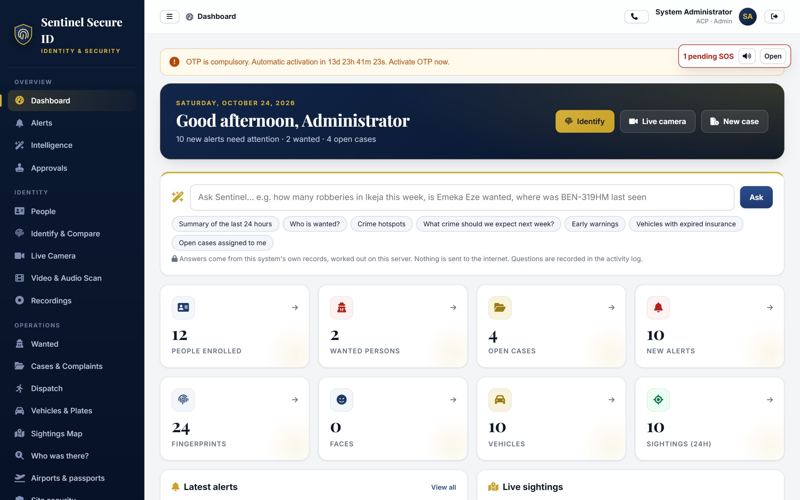
Sentinel ID
Identity, investigation and emergency response
Platform overview and illustrative operational scenarios
SentinelSecureID.com
01
Notes:
Opening: introduce the platform as software for authorised identity investigation and field response. Describe deployment and provider dependencies during the demonstration. This presentation does not assert a live national installation or measured superiority over other security systems.
Sources: local implementation in C:/workspace/fingerprint/fingersoftware and product copy in C:/workspace/fingerprint/fingerweb/content/product-overview.json. Interface images use fictional demonstration records.

Slide 2
The operational problem
Changing identity details
A phone number can change hands. Investigators need dates and history.
Interrupted field work
A dropped call or weak data connection needs an explicit follow-up path.
Scattered responsibility
Evidence, dispatches and decisions need a connected handling record.
SentinelSecureID.com
02
Notes:
The following describes common workflow challenges, not measured customer findings. Explain how fragmented records, changing phone numbers, lost connectivity and unacknowledged emergencies can interrupt an investigation.
Sources: local implementation in C:/workspace/fingerprint/fingersoftware and product copy in C:/workspace/fingerprint/fingerweb/content/product-overview.json. Interface images use fictional demonstration records.

Slide 3
The platform at a glance
Control room
Cases, identity records and operational oversight
Field application
Approved Android devices with dispatch and SOS
Partner APIs
Scoped, authorised access
SentinelSecureID.com
03
Notes:
The web platform supports control-room and investigative work. The Android application supports approved phones and tablets. Scoped APIs support authorised partner and camera integration. Available functionality follows the role, agency and configured deployment.
Sources: local implementation in C:/workspace/fingerprint/fingersoftware and product copy in C:/workspace/fingerprint/fingerweb/content/product-overview.json. Interface images use fictional demonstration records.

Slide 4
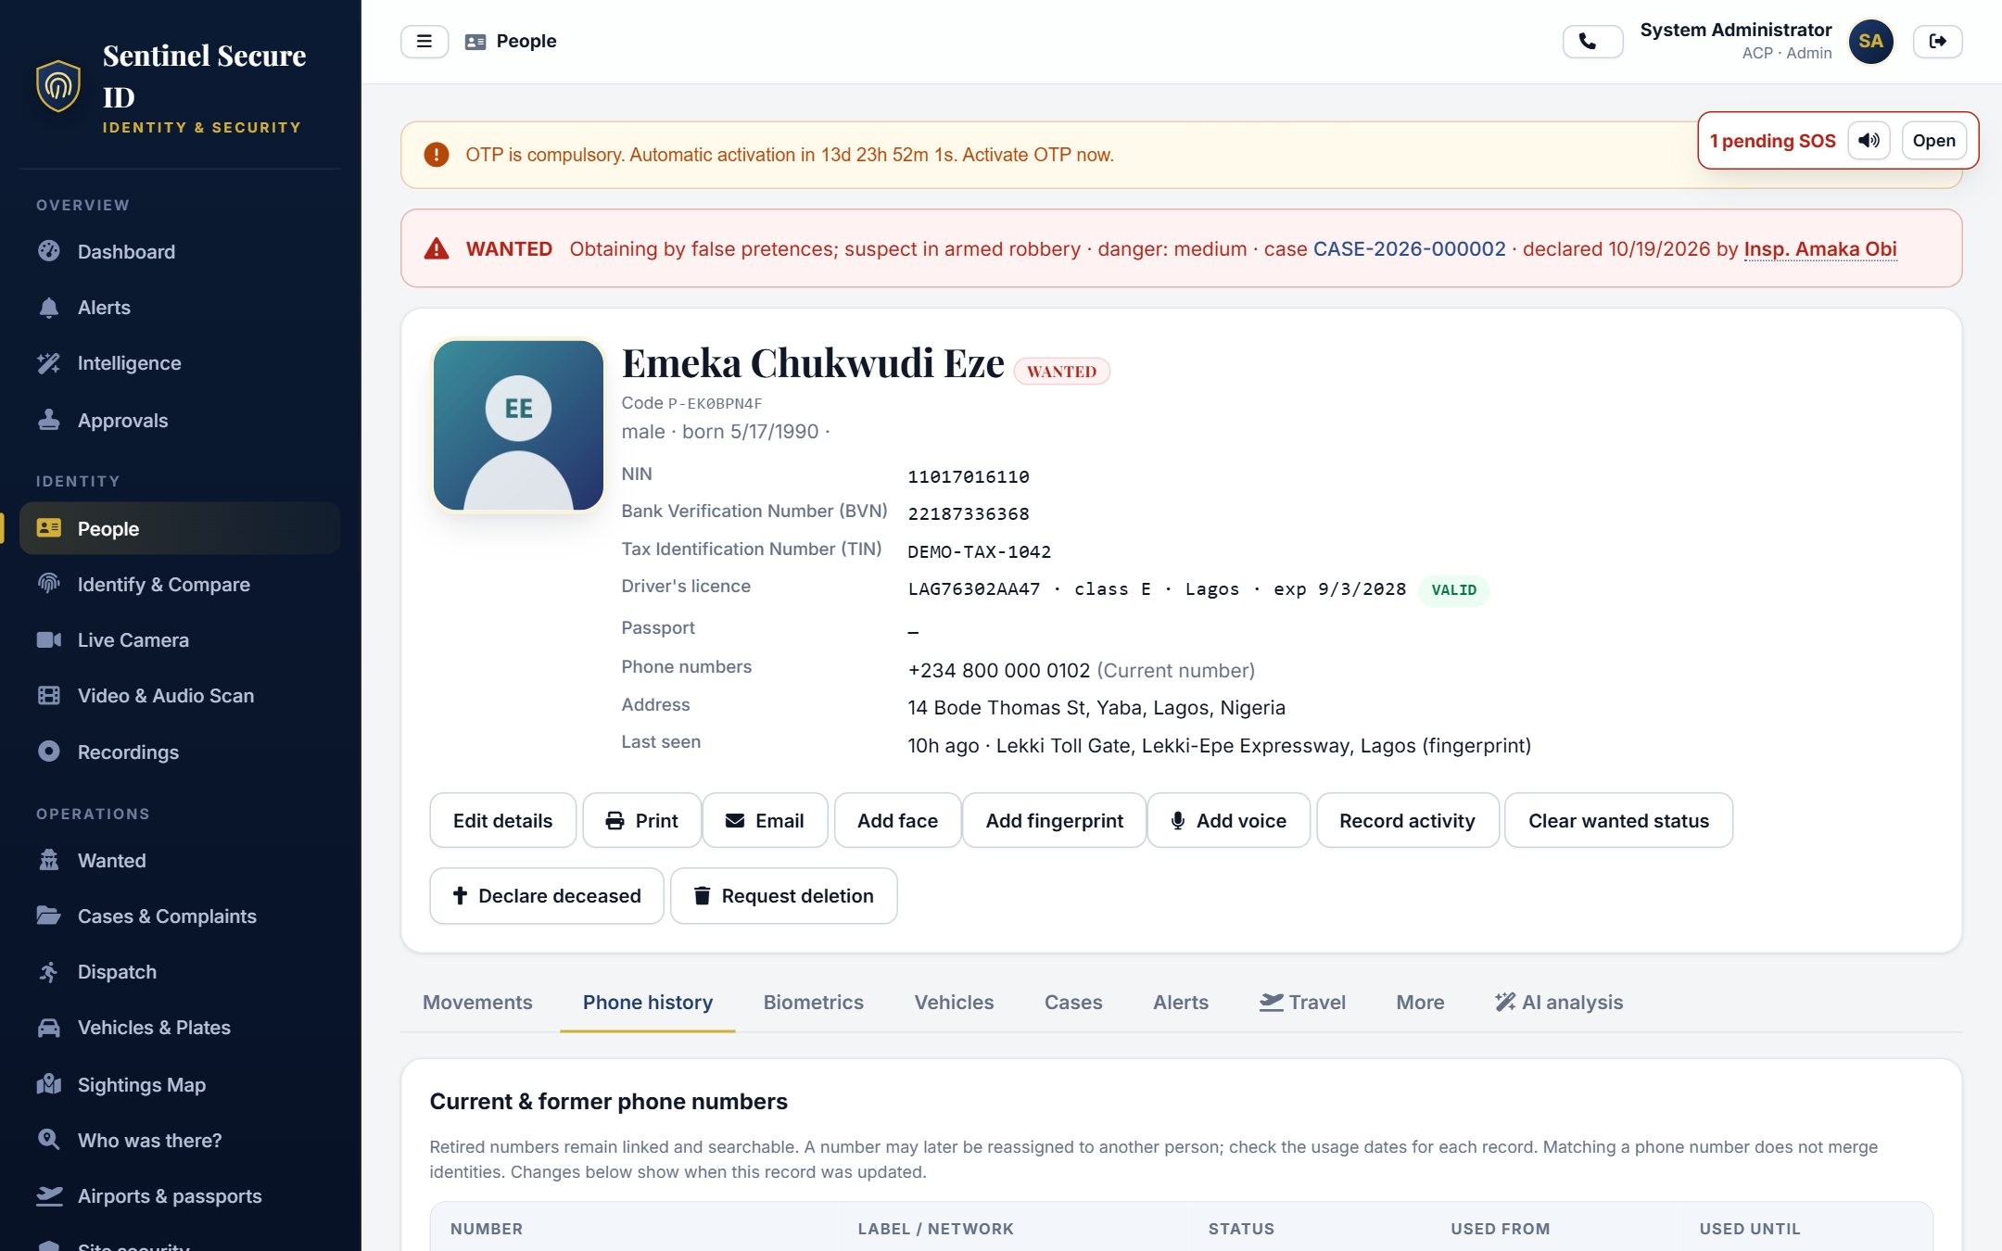
Identity details with a history
Configurable identifiers
National ID, Bank ID and TAX ID labels follow the organisation.
More than one contact
Multiple phone numbers and bank accounts belong in the profile.
Dates matter
Retired numbers and later reassignments retain their context.
Demonstration person profile
SentinelSecureID.com
04
Notes:
A phone number is not a permanent identity key. Review dates, case context and other identifiers before reaching a conclusion. Authorised external verification requires an actual provider integration.
Sources: local implementation in C:/workspace/fingerprint/fingersoftware and product copy in C:/workspace/fingerprint/fingerweb/content/product-overview.json. Interface images use fictional demonstration records.

Slide 5
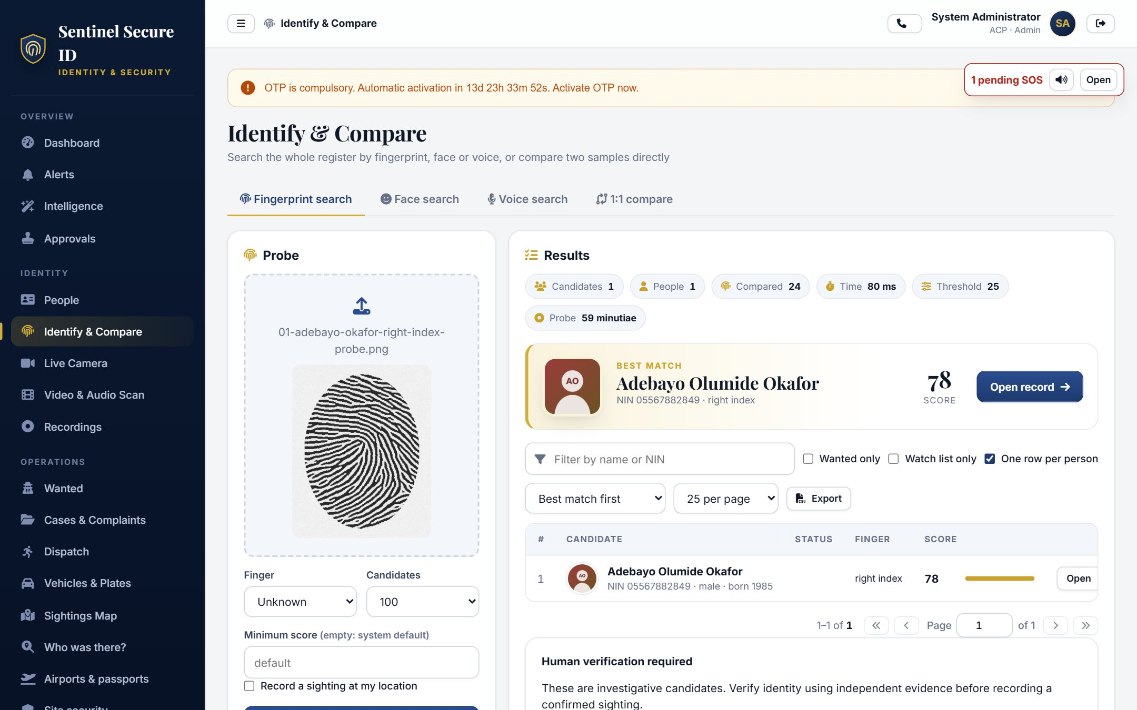
Biometric candidates for review
Fingerprint investigation
Identify, verify and compare supported submitted fingerprint samples.
Faces and voices
Search registered records using supported photo, video and audio workflows.
Controlled interpretation
Review candidates, thresholds and capture quality before acting.
Candidate matches are investigative leads
SentinelSecureID.com
05
Notes:
A candidate result is not proof of identity. Quality checks, liveness and independent evaluation require appropriate configuration and representative testing. The Android built-in sensor unlocks the app and does not export search fingerprints.
Sources: local implementation in C:/workspace/fingerprint/fingersoftware and product copy in C:/workspace/fingerprint/fingerweb/content/product-overview.json. Interface images use fictional demonstration records.

Slide 6
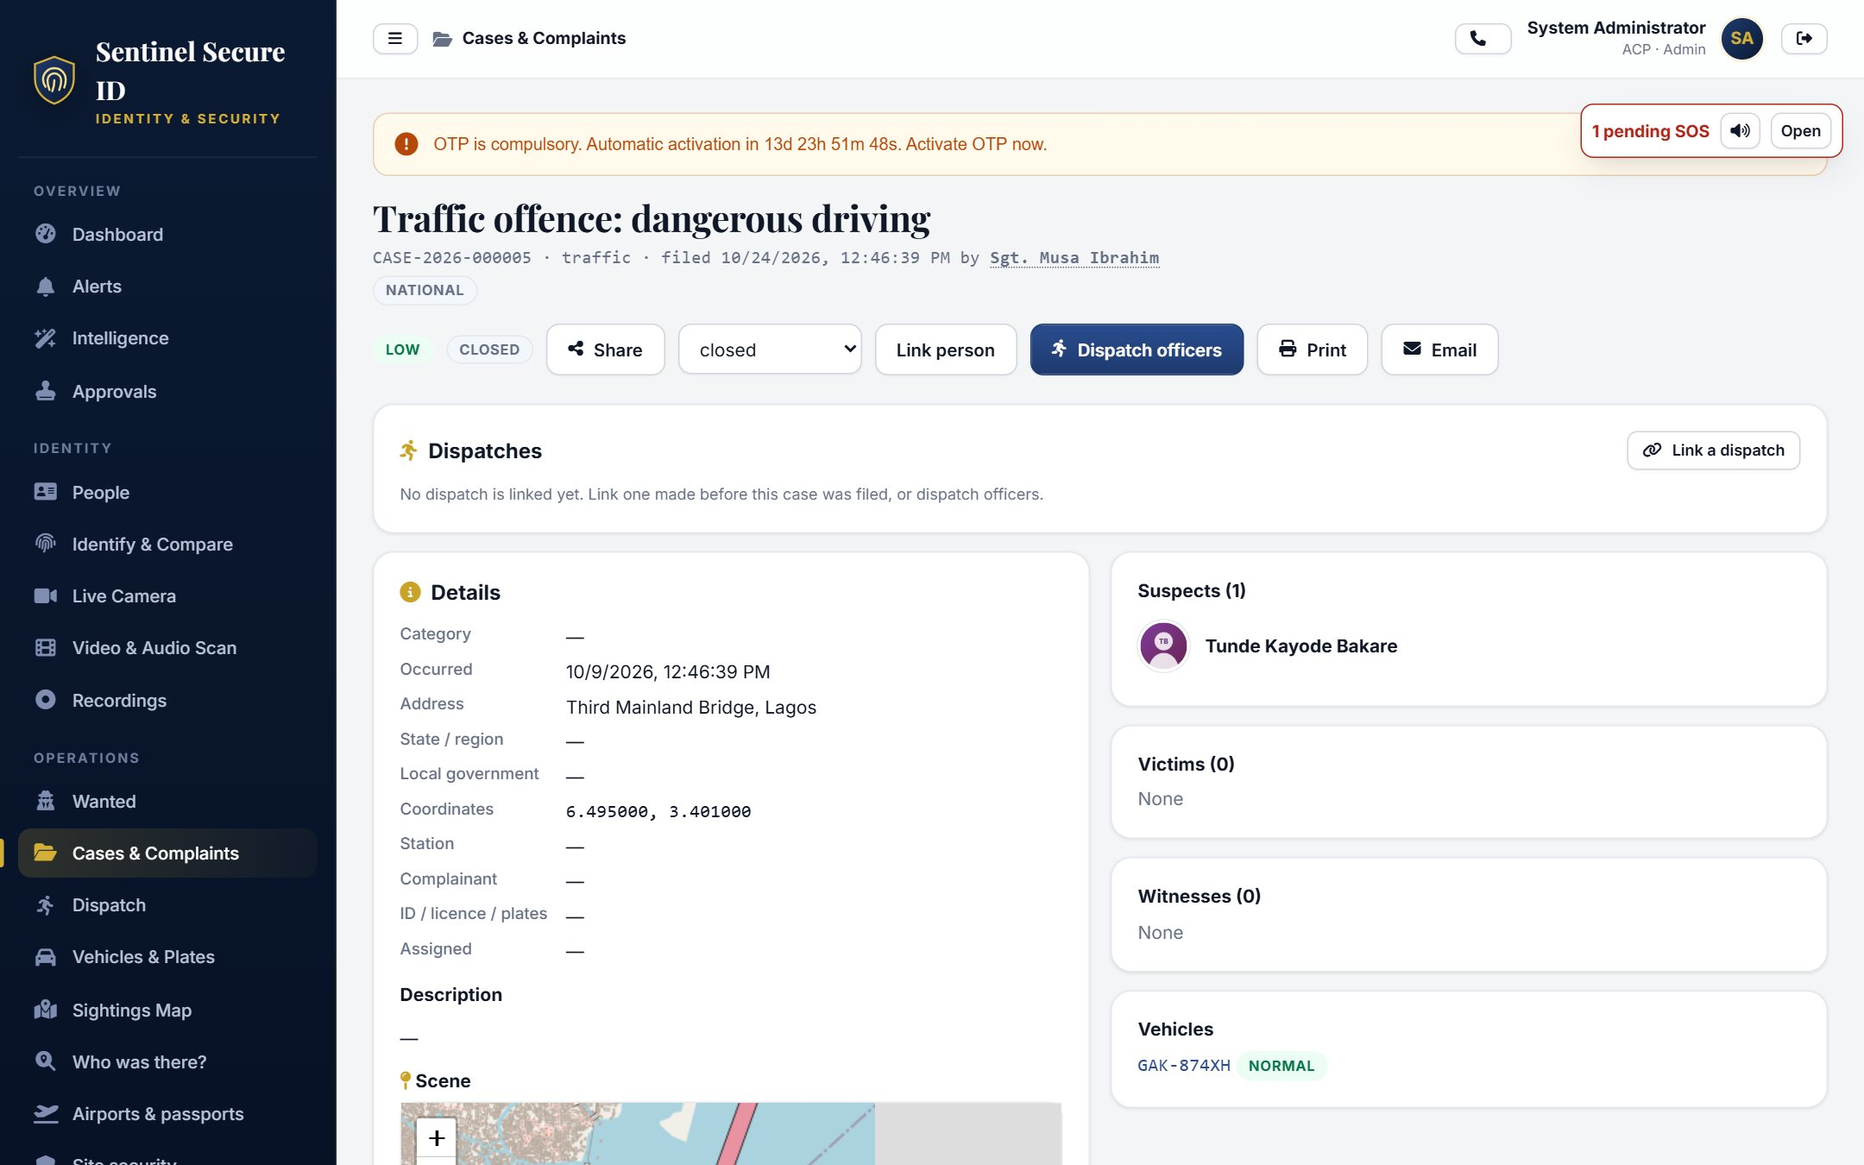
Complaints, cases and evidence
Connected case work
Link people, vehicles, scene locations and attachments.
Visible responsibility
Reassign cases, track overdue work and send update reminders.
Integrity and handling
Digests, configured signatures and custody records support review.
Demonstration case workspace
SentinelSecureID.com
06
Notes:
Evidence signatures and encrypted backups require protected signing/encryption keys. A digital integrity record supports handling review and does not by itself establish legal admissibility. Complaint spelling suggestions require user choice.
Sources: local implementation in C:/workspace/fingerprint/fingersoftware and product copy in C:/workspace/fingerprint/fingerweb/content/product-overview.json. Interface images use fictional demonstration records.

Slide 7
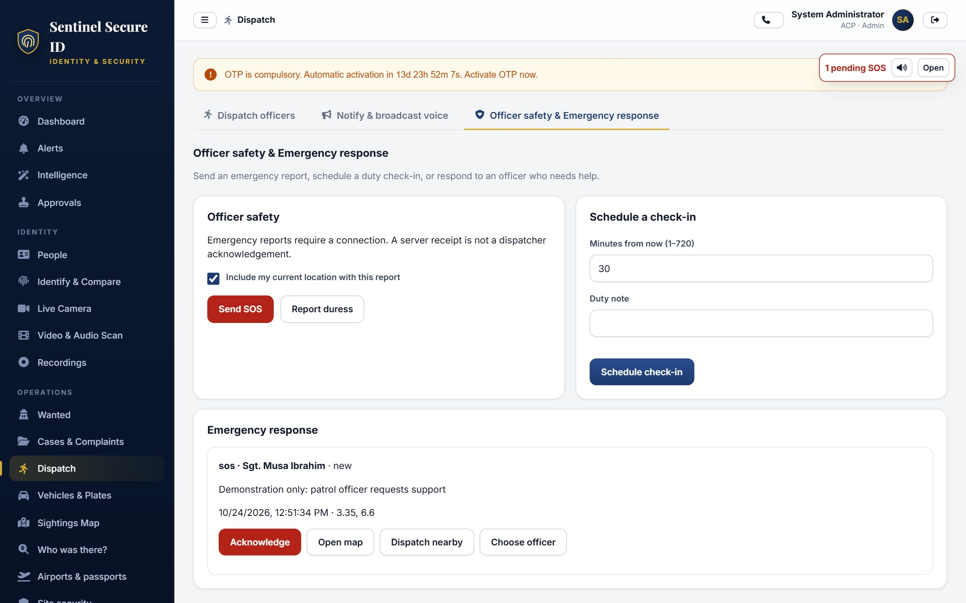
SOS response and callback
Persistent attention
A small minimized badge stays pending until control acknowledges it.
An audible new alert
A new emergency sounds an alarm, subject to browser permission.
Follow-up and response
Open reported coordinates, dispatch a responder and call the officer back.
Dispatches await the responding officer’s acceptance
SentinelSecureID.com
07
Notes:
GPS is optional and failures do not prevent sending an SOS without coordinates. Nearby search depends on known positions and their age. Callback targets the originating officer after a missed or dropped direct call. Calls across networks may require a relay.
Sources: local implementation in C:/workspace/fingerprint/fingersoftware and product copy in C:/workspace/fingerprint/fingerweb/content/product-overview.json. Interface images use fictional demonstration records.

Slide 8
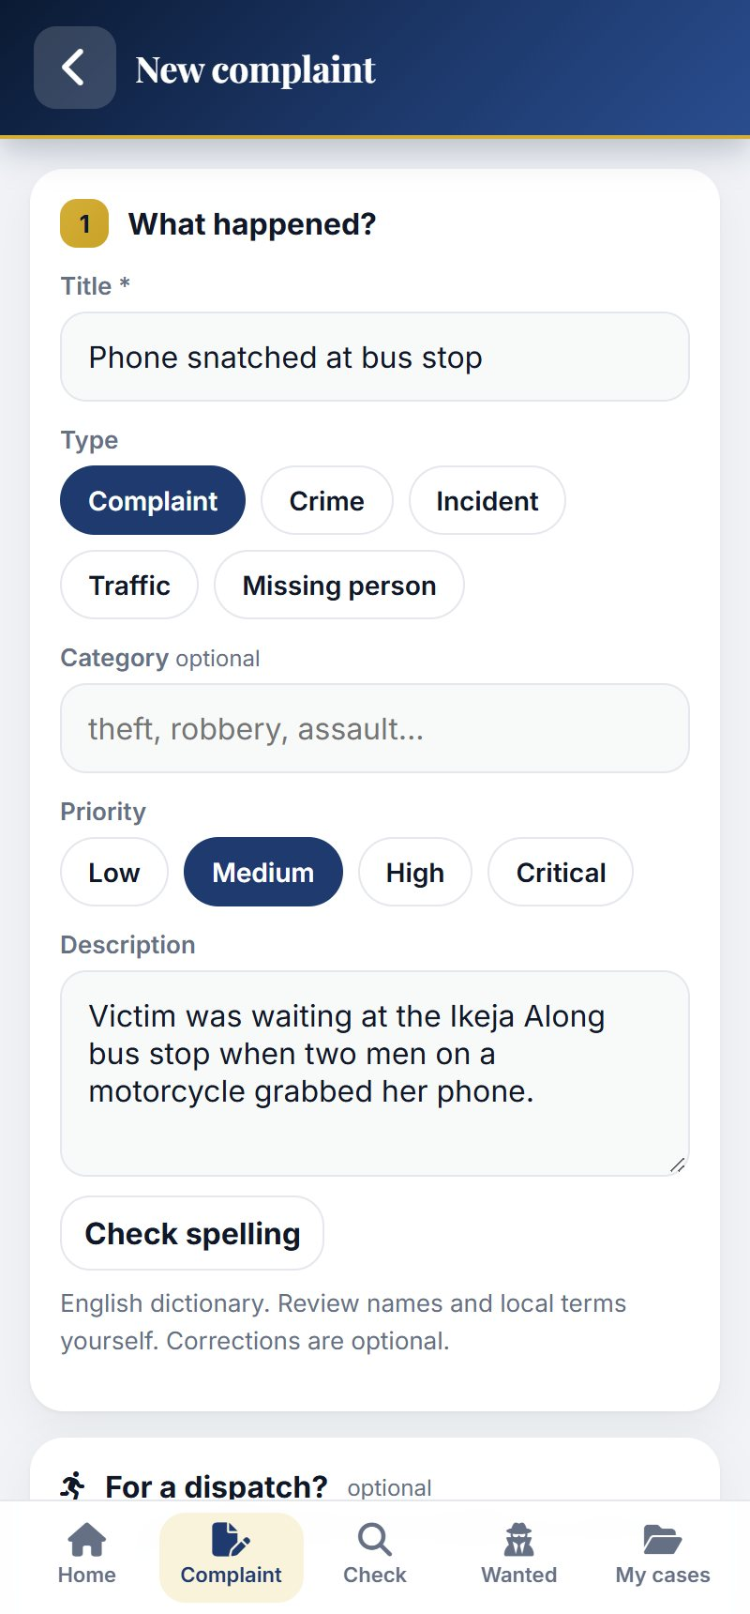
Android phones and tablets
Approved device access
Secure storage with supported device biometrics or PIN unlock
Work through weak connectivity
Encrypted drafts, offline authorisation limits and retry after reconnection
External scanner or imported sample for identity fingerprints
SentinelSecureID.com
08
Notes:
Device approval, secure storage and session controls support field access. Compatible native biometrics or a PIN unlock the application. The built-in fingerprint sensor does not supply biometric identity-search data. Encrypted complaint drafts can synchronise after connectivity returns. Native hardware and SDK integrations require validation on the actual target devices.
Sources: local implementation in C:/workspace/fingerprint/fingersoftware and product copy in C:/workspace/fingerprint/fingerweb/content/product-overview.json. Interface images use fictional demonstration records.

Slide 9
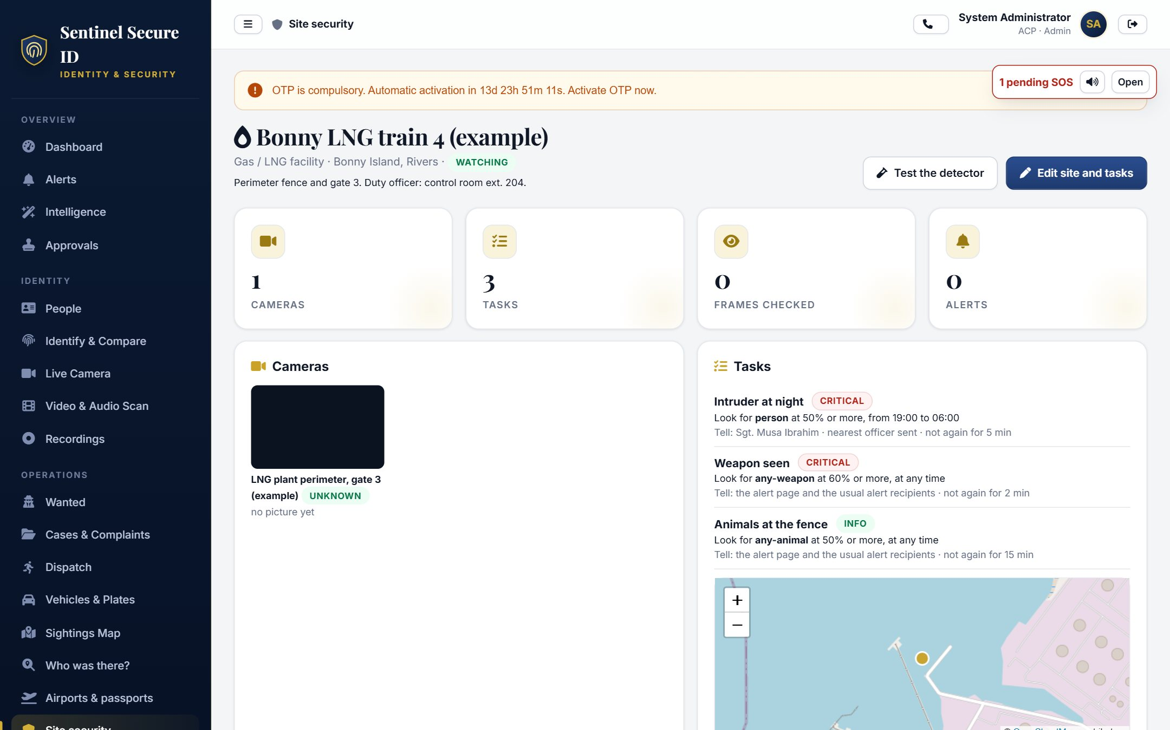
Camera observations and site rules
Connection choices
Image uploads, NVR / RTSP sources and relayed RTMP / SRT streams.
Controlled ingest
Dedicated keys protect ingest. Preview and stop each site camera.
Operational context
Plate flags, site rules and sighting history support reviewed alerts.
Demonstration guarded-site workspace
SentinelSecureID.com
09
Notes:
Image-push ingest does not require source-IP allowlisting. The camera still needs network reachability and its valid key. Recognition and object detection depend on capture quality, supported formats and the deployed detector configuration.
Sources: local implementation in C:/workspace/fingerprint/fingersoftware and product copy in C:/workspace/fingerprint/fingerweb/content/product-overview.json. Interface images use fictional demonstration records.

Slide 10
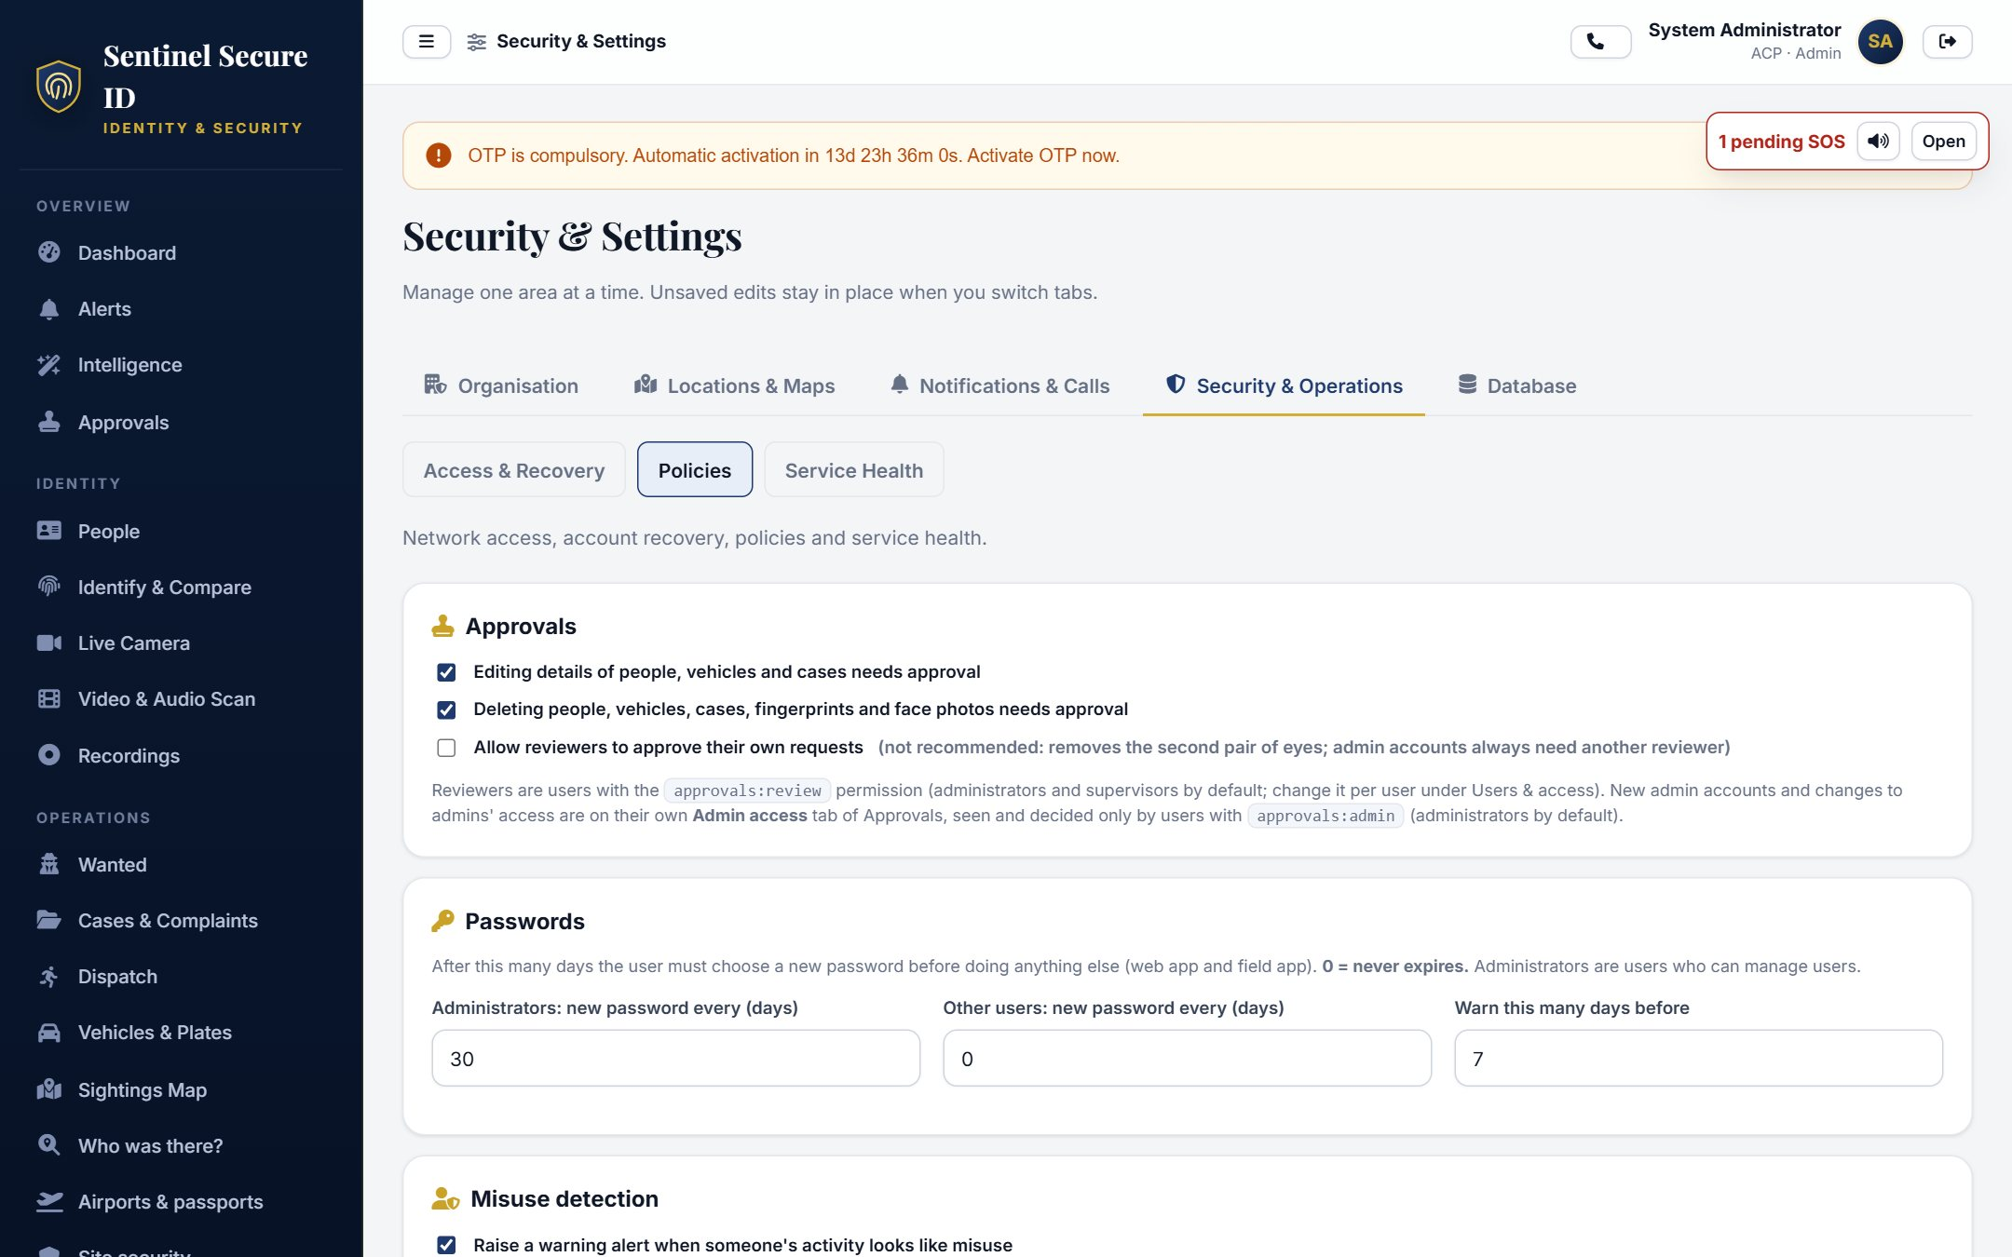
Account controls and accountability
Web authentication
Authenticator OTP, recovery codes and one active account login.
Scoped access
Approved clients, agency boundaries and expiring permissions.
Operational assurance
Audit delivery, evidence controls and encrypted backup tooling.
Security & Settings / demonstration installation
SentinelSecureID.com
10
Notes:
Web accounts follow the configured 14-day OTP policy and permitted recovery/administration. Approved native mobile sessions follow device security rather than the web OTP challenge. External archives, attestation and release verification require configured infrastructure and keys.
Sources: local implementation in C:/workspace/fingerprint/fingersoftware and product copy in C:/workspace/fingerprint/fingerweb/content/product-overview.json. Interface images use fictional demonstration records.

Slide 11
Configured capability and deployment readiness
Implemented workflows
Deployment dependencies
Identity history and case review
SOS, callback and dispatch
Approved workspace clients
Site detection and training
Paginated search and reporting
Authorised verifier providers
Capture and hardware validation
Protected keys and HTTPS
Network and voice relay setup
Capacity and restore testing
A configuration entry alone does not activate an external service
SentinelSecureID.com
11
Notes:
The implementation includes adapters for external audit archiving, fingerprint quality, capture assurance, device attestation and National/Bank/TAX ID verification. A disabled/not configured integration is not an active service. Real provider contracts, authority, credentials and certificates are prerequisites. No quantitative capacity, uptime or recognition guarantee is asserted.
Sources: local implementation in C:/workspace/fingerprint/fingersoftware and product copy in C:/workspace/fingerprint/fingerweb/content/product-overview.json. Interface images use fictional demonstration records.

Slide 12
Illustrative scenario: an SOS call drops
01 Report
An officer sends SOS. The call to headquarters drops.
02 Review
Control hears the new alert and opens the pending report.
03 Respond
Control sends a selected officer and calls the originating officer back.
04 Follow up
Control acknowledges the report and tracks responder acceptance.
SentinelSecureID.com
12
Notes:
This is an illustrative workflow rather than a verified deployment or measured response-time claim. An officer reports SOS and the headquarters call drops. Control sees the pending badge and hears the new-alert sound. It checks available coordinates and position age, selects a responder and uses callback to reach the original officer. Acknowledgement and dispatch acceptance are distinct states.
Sources: local implementation in C:/workspace/fingerprint/fingersoftware and product copy in C:/workspace/fingerprint/fingerweb/content/product-overview.json. Interface images use fictional demonstration records.

Slide 13
Illustrative scenario: a number changes hands
Earlier assignment
Later assignment
The first person’s record retains the retired number and dates.
The second person’s current contact record reflects the later assignment.
The investigator reviews time, identifiers and case context before deciding what the overlap means.
SentinelSecureID.com
13
Notes:
This scenario does not describe a named customer or actual investigation. A number once used by one person later belongs to another. Historical and active assignments should be assessed using their relevant dates and independent identifiers. A shared number is not proof that two records represent one person.
Sources: local implementation in C:/workspace/fingerprint/fingersoftware and product copy in C:/workspace/fingerprint/fingerweb/content/product-overview.json. Interface images use fictional demonstration records.

Slide 14
A pilot with measured acceptance criteria
01
Scope and authority
Users, records, integrations and permitted uses
02
Representative trial
Target scanners, cameras, Android devices and network conditions
03
Operational testing
False matches, dropped calls, offline retry and backup restoration
04
Acceptance and expansion
Recorded results against agreed criteria
SentinelSecureID.com
14
Notes:
Agree the data authority and operational scope first. Demonstrate representative workflows on intended hardware. Define acceptance measures such as task completion, match-review outcomes, query latency, delivery success and restore validation. Record observed results and address dependencies before expanding coverage. Performance targets should be agreed, measured and documented rather than inferred from a sizing plan.
Sources: local implementation in C:/workspace/fingerprint/fingersoftware and product copy in C:/workspace/fingerprint/fingerweb/content/product-overview.json. Interface images use fictional demonstration records.

Slide 15
Approved workspace access
Installation approval
Register each installation once. An authorised administrator approves its device key.
Device checks
The server checks that the installation is approved and rejects reused or expired requests.
Account verification
An authorised account supplies a current authenticator code when verification is required.
Idle stop
After one hour without application traffic, the client stops until the user presses Start.
The client carries Sentinel ID traffic only. The browser uses a random local port.
SentinelSecureID.com
15
Notes:
Sources: vpn/README.md; src/modules/connect/connect.service.js; src/core/security/connect.js. A copied folder does not grant another installation approval. Endpoint key protection still depends on the OS.
Verified against local Sentinel ID source on 26 October 2026. Configuration and deployment conditions apply.

Slide 16
Public gateway, private application
Separate gateway
Browser pages, APIs, uploads and live connections travel through the HTTPS gateway.
Private connection
The application server connects to the gateway. Staff do not connect directly to the private server.
Field and partner APIs
Approved Field devices and scoped APIs use their own controls without a desktop client.
Private infrastructure
The application and database can stay on a protected network with access through the gateway.
Plan gateway capacity around the number of connections and the amount of video and other traffic.
SentinelSecureID.com
16
Notes:
Source: vpn/server/README.md and vpn/server gateway/private-agent implementation. API account/key IP restrictions apply when enabled. No unconditional throughput or availability claim.
Verified against local Sentinel ID source on 26 October 2026. Configuration and deployment conditions apply.

Slide 17
Sessions and temporary permissions
One active login
A new login replaces the previous device session for that account.
Authenticator policy
Eligible web users see the compulsory enrolment countdown and profile security controls.
Permission expiry
Authorised staff grant additional permissions for a selected number of days.
Recovery and access
Password and security changes end earlier sessions. Recovery codes help users regain access.
Native Field sessions follow approved-device controls instead of the web OTP requirement.
SentinelSecureID.com
17
Notes:
Sources: src/core/middleware/auth.js; src/core/config/permissions.js; src/modules/auth; docs/SECURITY-OPERATIONS.md.
Verified against local Sentinel ID source on 26 October 2026. Configuration and deployment conditions apply.

Slide 18
Team scope and sensitive changes
Case review
Unit / Station and agency permissions determine who may approve a case.
Identity suggestions
Review proposed case links, missing biometrics and possible duplicate people.
Biometric removal
A dedicated removal permission and special approval protect deletion requests.
Evidence and activity
Check evidence for file changes, review its handling history and control who can download records.
Self-review follows the configured approval policy. A biometric candidate remains a lead.
SentinelSecureID.com
18
Notes:
Sources: docs/IDENTITY-SPECIAL-APPROVALS.md; src/core/config/permissions.js; src/modules/assurance; src/modules/cases. External archives and signing services require configuration.
Verified against local Sentinel ID source on 26 October 2026. Configuration and deployment conditions apply.

Slide 19
Site security and live detection
Register the site
Record its location, assigned cameras, operating period and detection rules.
Review camera coverage
Connect supported sources and check capture quality, placement and network reachability.
Preview on request
Start and stop individual previews. Opening the site does not automatically play every camera.
Detect and respond
Configured background detection, watchlist matches and site rules feed alerts and response workflows.
Background monitoring requires connected cameras, enabled rules and working detection workers.
SentinelSecureID.com
19
Notes:
Sources: src/modules/sites/sites.routes.js; sites.service.js; public/js/components/site-cameras.js. Site security is the implemented workflow, not a separate survey form.
Verified against local Sentinel ID source on 26 October 2026. Configuration and deployment conditions apply.

Slide 20
Training with validation before activation
Collect and label
Add authorised pictures, draw object boxes and include representative background scenes.
Continue training
Add examples to existing data or continue from a previous model without replacing the active one first.
Separate test data
Keep test pictures out of training. Check for missed objects and false alarms across complete camera images.
Review before use
Review a model’s test results before activating it. A failed training run leaves the previous model in place.
Test detection with the cameras and conditions where it will be used.
SentinelSecureID.com
20
Notes:
Sources: src/modules/sites/training.service.js; training-samples.service.js; detector-evaluation.js; docs/SITE-LIVE-TRAINING.md. Current public-data weapon candidate remains inactive after failing validation.
Verified against local Sentinel ID source on 26 October 2026. Configuration and deployment conditions apply.

Slide 21
Your workflow,
demonstrated
SentinelSecureID.com
Demonstrations and proposals: SentinelSecureID.com/support
SentinelSecureID.com
21
Notes:
Close by inviting an agency-specific demonstration through SentinelSecureID.com/support. Bring approved sample data and representative hardware. Do not promise access to partner databases, certified performance or deployment capacity without evidence and the required agreements.
Sources: local implementation in C:/workspace/fingerprint/fingersoftware and product copy in C:/workspace/fingerprint/fingerweb/content/product-overview.json. Interface images use fictional demonstration records.

