Slide 1


VISUAL PRODUCT PRESENTATION
Sentinel SiteGuard
Company camera monitoring and building access tied to accountable records.
Current screens · Visual workflows · Deployment detail
Generated concept illustration
Notes:
Source: Sentinel SiteGuard current application README, implementation documentation and configured-test-system captures. Generated scenes are illustrative, not customer deployments.
Company camera monitoring and building access tied to accountable records.
Product proposal
Prepared for organisations assessing Sentinel SiteGuard. This is a product overview and proposed implementation approach, not a signed offer or statement of completed deployment.
Edition
31 October 2026
Product scope
Sentinel SiteGuard is the facility-security product. It is separate from the national identity system, Sentinel Assure workspaces and Sentinel SkyWatch. Collection permits are a review register, not an ERP or weighbridge integration.
Visual source: assets/products/siteguard-hero.png
Generated concept illustration.

Slide 2

SENTINEL SITEGUARD
Executive overview
Camera monitoring, restricted-area alerts, staff and visitor access, and collection authorizations for company facilities.
The operational outcome
Camera events and access decisions with records that can be reviewed.
Who uses it
Company security managers, control rooms and front-desk teams
Generated illustrative scenario; not a customer deployment.
Sentinel SiteGuard
02
Notes:
Source: Sentinel SiteGuard current application README, implementation documentation and configured-test-system captures. Generated scenes are illustrative, not customer deployments.
Camera monitoring, restricted-area alerts, staff and visitor access, and collection authorizations for company facilities.
Intended team
Company security managers, control rooms and front-desk teams
Operational outcome
Camera events and access decisions with records that can be reviewed.
Implementation boundary
Company camera monitoring and building access tied to accountable records. Requirements depend on the chosen host, inputs, permissions and agreed integration scope.
Decision context
The organisation retains responsibility for authorised use, staff decisions, source data and commissioning. Illustrative scenarios are examples, not customer testimonials.
Visual source: assets/products/illustrations/products-scenarios.png
Generated illustrative scenario; not a customer deployment.

Slide 3

SENTINEL SITEGUARD
Users and responsibilities
Clear ownership supports accountable operation.
Security manager
Configure areas and detection policies, register doors/lifts/floors and manage…
Front desk
Register visitors and manage bookings, card issuance and badge returns within assigned…
Guard / operator
Review camera alerts and check signed credentials at registered points.
Integration gateway
Use a scoped API key and commissioned vendor driver for mapped controller operations.
Generated illustrative scenario; not a customer deployment.
Sentinel SiteGuard
03
Notes:
Source: Sentinel SiteGuard current application README, implementation documentation and configured-test-system captures. Generated scenes are illustrative, not customer deployments.
Clear ownership supports accountable operation.
Security manager
Configure areas and detection policies, register doors/lifts/floors and manage current-assignment permissions.
Front desk
Register visitors and manage bookings, card issuance and badge returns within assigned permissions.
Guard / operator
Review camera alerts and check signed credentials at registered points.
Integration gateway
Use a scoped API key and commissioned vendor driver for mapped controller operations.
Visual source: assets/products/illustrations/about-scenarios.png
Generated illustrative scenario; not a customer deployment.

Slide 4
SENTINEL SITEGUARD
Operational workflow
The product follows its own recorded workflow.
01
02
03
04
Register the holder
Assign the credential
Grant an explicit route
Review the decision
Stage 1
Stage 2
Stage 3
Register areas, cameras and permitted entry points.
Configure monitoring rules and issue approved access or collection permits.
Review alerts and credentials, verify the person or vehicle, and record the outcome.
Sentinel SiteGuard
04
Notes:
Source: Sentinel SiteGuard current application README, implementation documentation and configured-test-system captures. Generated scenes are illustrative, not customer deployments.
The product follows its own recorded workflow.
Stage 1
Register areas, cameras and permitted entry points.
Stage 2
Configure monitoring rules and issue approved access or collection permits.
Stage 3
Review alerts and credentials, verify the person or vehicle, and record the outcome.

Slide 5
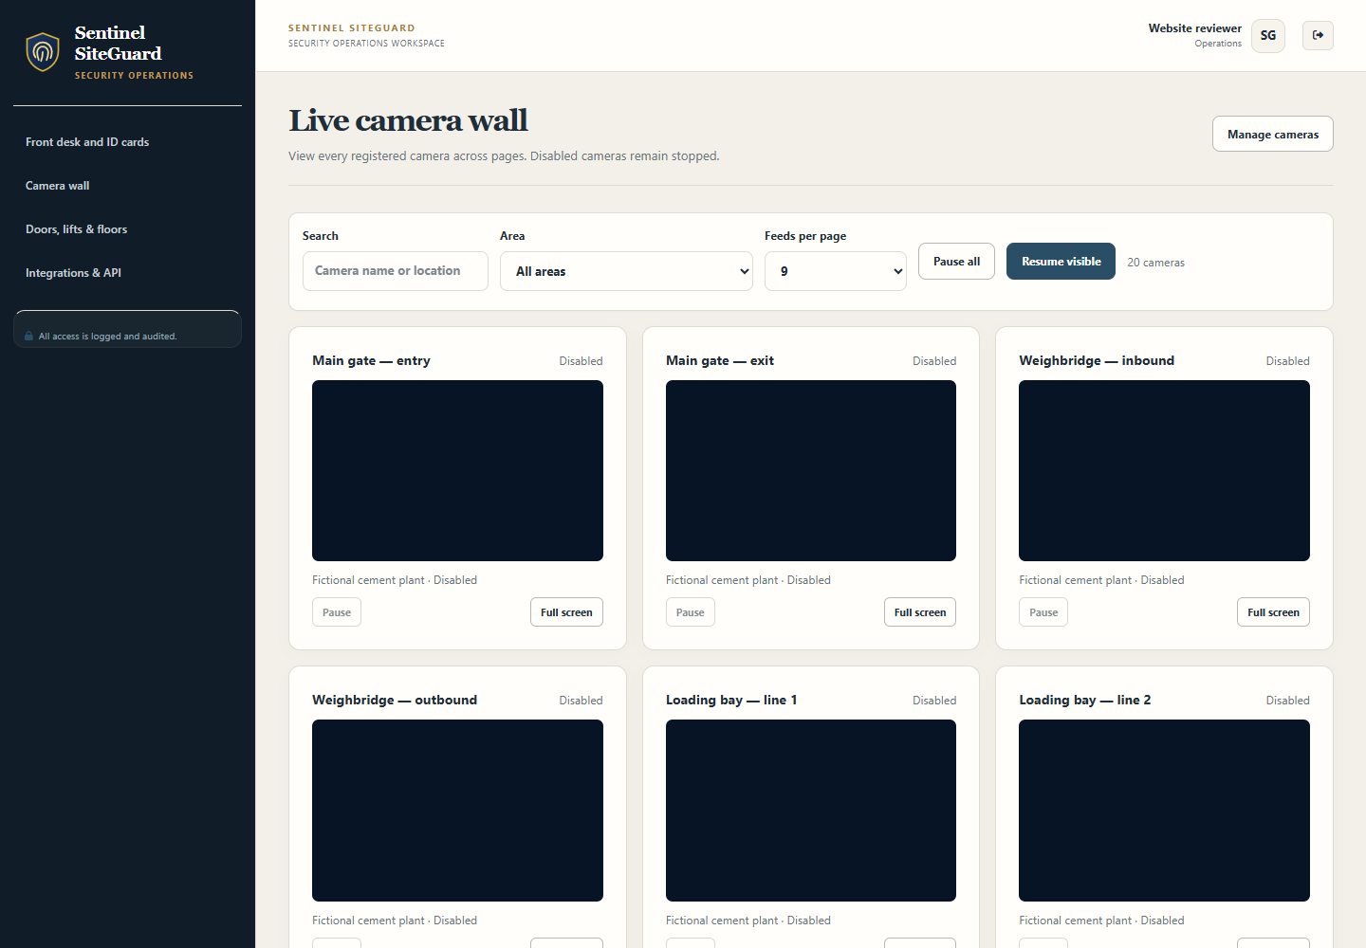
SENTINEL SITEGUARD
Site control room
Group cameras by area, review alerts and inspect detection readiness. Configure supported people and vehicle policies for the assigned coverage.
1
Assign cameras to the correct areas.
2
Review source images with the event.
3
Separate camera monitoring from entry policy.
Current interface; source connections are inactive in this test capture.
Sentinel SiteGuard
05
Notes:
Source: Sentinel SiteGuard current application README, implementation documentation and configured-test-system captures. Generated scenes are illustrative, not customer deployments.
Group cameras by area, review alerts and inspect detection readiness. Configure supported people and vehicle policies for the assigned coverage.
Operating approach
Schedules, thresholds and recipients should reflect the operational responsibilities. Monitoring state remains separate from the area’s physical-access policy.
What the team reviews
Assign cameras to the correct areas.
Review source images with the event.
Separate camera monitoring from entry policy.
Acceptance evidence
Demonstrate this workflow using representative permitted inputs. Record the expected result, actual result, responsible reviewer and any remaining conditions before production approval.
Visual source: assets/products/screens/siteguard-camera-wall.png
Current interface; source connections are inactive in this test capture.

Slide 6
SENTINEL SITEGUARD
Camera monitoring
Supported feeds and uploads support configured object detection and operator review. The camera wall supports reviewing several feeds.
01
02
03
04
Registered camera
Supported image input
Configured site event
Operator review
Operating approach
What the team reviews
Acceptance evidence
Image quality, placement and processing resources determine useful coverage.
Validate the actual stream and capture quality.
Demonstrate this workflow using representative permitted inputs.
Sentinel SiteGuard
06
Notes:
Source: Sentinel SiteGuard current application README, implementation documentation and configured-test-system captures. Generated scenes are illustrative, not customer deployments.
Supported feeds and uploads support configured object detection and operator review. The camera wall supports reviewing several feeds.
Operating approach
Image quality, placement and processing resources determine useful coverage. Model output does not establish intent or independently confirm identity.
What the team reviews
Validate the actual stream and capture quality.
Test day/night scenes and difficult conditions.
Keep an operator responsible for decisions.
Acceptance evidence
Demonstrate this workflow using representative permitted inputs. Record the expected result, actual result, responsible reviewer and any remaining conditions before production approval.

Slide 7
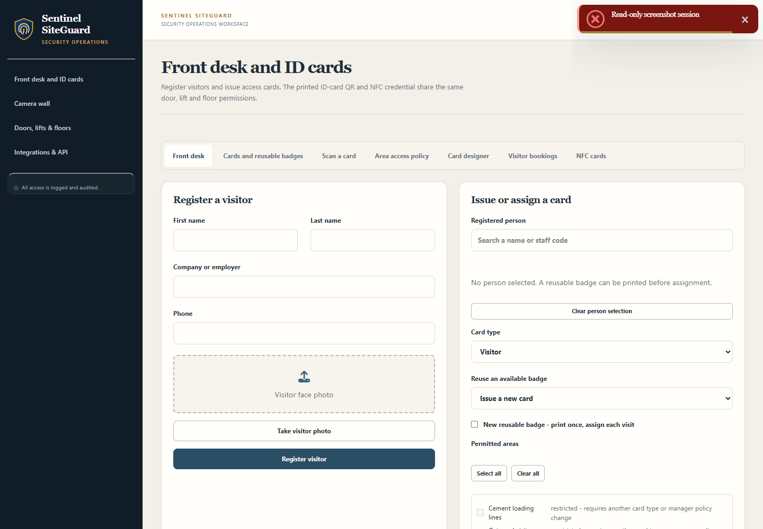
SENTINEL SITEGUARD
Visitors and reusable badges
The front desk registers permitted visitors, coordinates bookings and assigns or returns visitor badges.
1
Check approval, induction and visit state.
2
Compare the wearer with the registered holder.
3
Return, revoke or expire access promptly.
Current application interface captured from the configured test system.
Sentinel SiteGuard
07
Notes:
Source: Sentinel SiteGuard current application README, implementation documentation and configured-test-system captures. Generated scenes are illustrative, not customer deployments.
The front desk registers permitted visitors, coordinates bookings and assigns or returns visitor badges.
Operating approach
A reusable badge keeps its signed credential. The live assignment determines its current holder, dates and areas. Staff cards remain personal.
What the team reviews
Check approval, induction and visit state.
Compare the wearer with the registered holder.
Return, revoke or expire access promptly.
Acceptance evidence
Demonstrate this workflow using representative permitted inputs. Record the expected result, actual result, responsible reviewer and any remaining conditions before production approval.
Visual source: assets/products/screens/siteguard-front-desk.png
Current application interface captured from the configured test system.

Slide 8
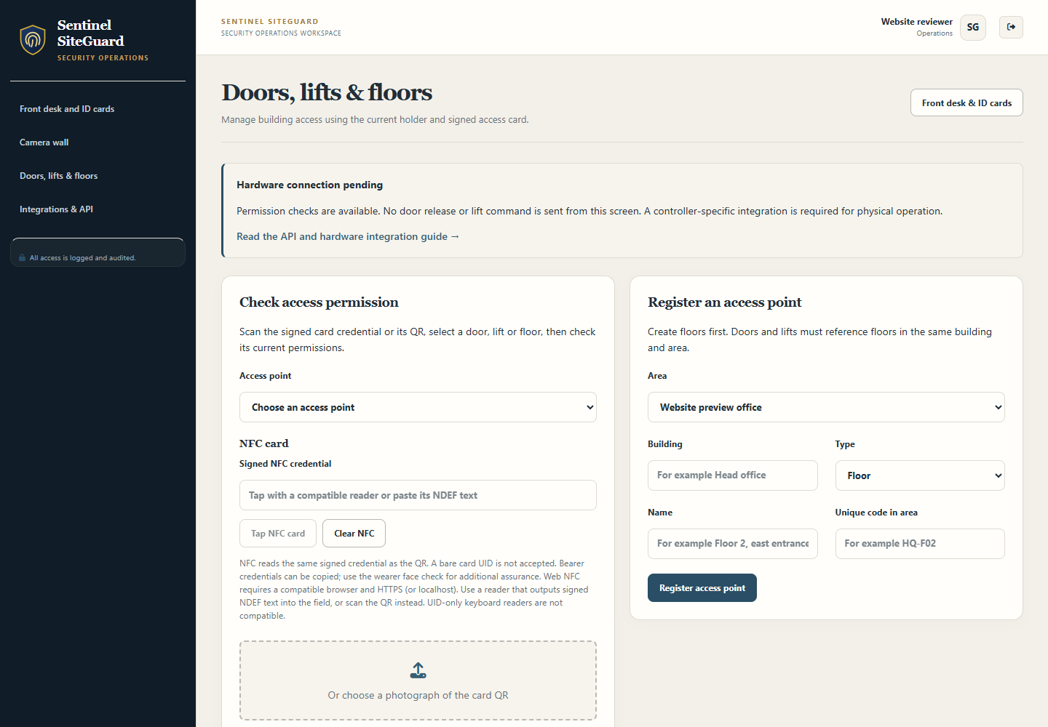
SENTINEL SITEGUARD
Doors, lifts and floors
Register floors, doors linked to floors and lifts with served destinations. Grant explicit points to the current card assignment.
1
A text floor label grants no physical entry.
2
Reassignment does not inherit old grants.
3
Changes affect both QR and NFC immediately.
Current application interface captured from the configured test system.
Sentinel SiteGuard
08
Notes:
Source: Sentinel SiteGuard current application README, implementation documentation and configured-test-system captures. Generated scenes are illustrative, not customer deployments.
Register floors, doors linked to floors and lifts with served destinations. Grant explicit points to the current card assignment.
Operating approach
The printed ID-card QR and NFC copy share the same signed credential and permission record. A door needs its floor; a lift needs its requested served destination.
What the team reviews
A text floor label grants no physical entry.
Reassignment does not inherit old grants.
Changes affect both QR and NFC immediately.
Acceptance evidence
Demonstrate this workflow using representative permitted inputs. Record the expected result, actual result, responsible reviewer and any remaining conditions before production approval.
Visual source: assets/products/screens/siteguard-access.png
Current application interface captured from the configured test system.

Slide 9
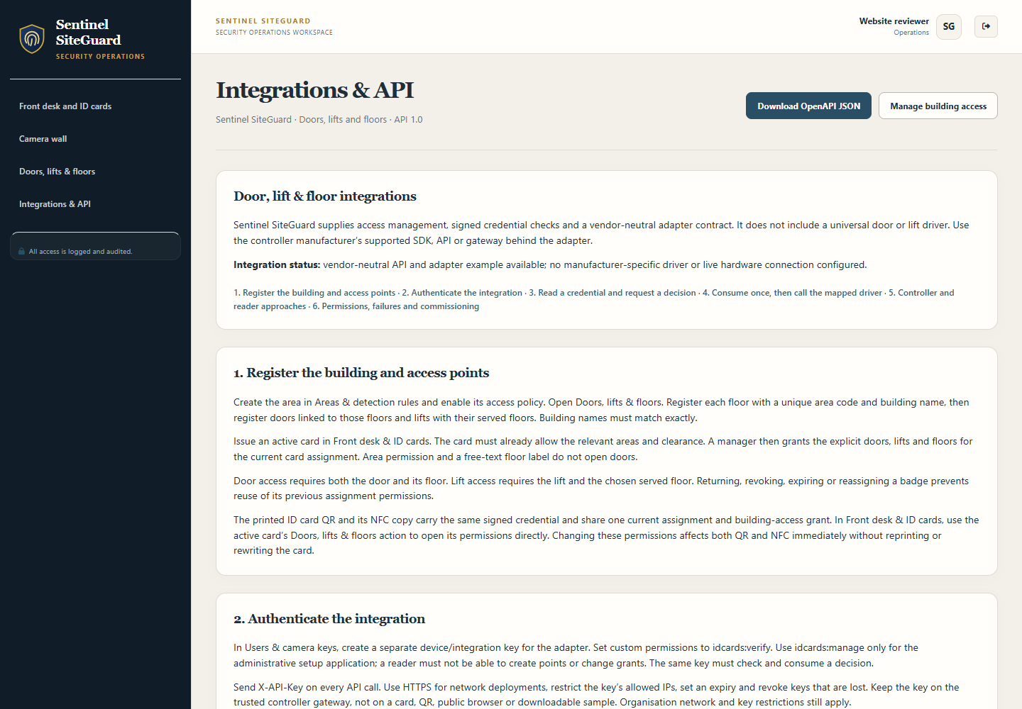
SENTINEL SITEGUARD
Hardware integration API
The API checks a credential and issues a short-lived decision. The same integration key consumes it once before a trusted adapter calls the mapped vendor driver.
1
Use a dedicated scoped integration key.
2
Map only the approved door or lift floor.
3
Deny on stale, failed or ambiguous responses.
Current application interface captured from the configured test system.
Sentinel SiteGuard
09
Notes:
Source: Sentinel SiteGuard current application README, implementation documentation and configured-test-system captures. Generated scenes are illustrative, not customer deployments.
The API checks a credential and issues a short-lived decision. The same integration key consumes it once before a trusted adapter calls the mapped vendor driver.
Operating approach
The in-app guide includes API examples, OpenAPI and failure behavior. Manufacturer-specific hardware drivers require separate setup and commissioning.
What the team reviews
Use a dedicated scoped integration key.
Map only the approved door or lift floor.
Deny on stale, failed or ambiguous responses.
Acceptance evidence
Demonstrate this workflow using representative permitted inputs. Record the expected result, actual result, responsible reviewer and any remaining conditions before production approval.
Visual source: assets/products/screens/siteguard-integrations.png
Current application interface captured from the configured test system.

Slide 10
SENTINEL SITEGUARD
Collection review and auditing
Collection permits link plates, dispatch references and a bounded validity window for supervisor review.
01
02
03
04
Permit and vehicle
Person and paperwork
Review validity window
Record the outcome
Operating approach
What the team reviews
Acceptance evidence
A matching permit informs review without proving the truck, driver or load is correct.
Verify vehicle, driver and paperwork.
Demonstrate this workflow using representative permitted inputs.
Sentinel SiteGuard
10
Notes:
Source: Sentinel SiteGuard current application README, implementation documentation and configured-test-system captures. Generated scenes are illustrative, not customer deployments.
Collection permits link plates, dispatch references and a bounded validity window for supervisor review.
Operating approach
A matching permit informs review without proving the truck, driver or load is correct. Access history records permission checks rather than independently confirmed physical entry.
What the team reviews
Verify vehicle, driver and paperwork.
Separate manager and guard responsibilities.
Use controller telemetry for physical confirmation.
Acceptance evidence
Demonstrate this workflow using representative permitted inputs. Record the expected result, actual result, responsible reviewer and any remaining conditions before production approval.

Slide 11
SENTINEL SITEGUARD
Architecture and information flow
Components and responsibilities for this product.
Database and evidence
Browser and front desk
Application service
Controller gateway
Product-specific information flow
Sentinel SiteGuard
11
Notes:
Source: Sentinel SiteGuard current application README, implementation documentation and configured-test-system captures. Generated scenes are illustrative, not customer deployments.
Components and responsibilities for this product.
Browser and front desk
Monitoring, visitors and current-assignment management.
Application service
Card, booking, area, clearance, point and floor decisions.
Database and evidence
MongoDB and protected configured evidence storage.
Controller gateway
Single-use decisions and an administrator-mapped vendor driver.

Slide 12
SENTINEL SITEGUARD
Integrations and commissioning
Each connection requires authorised configuration.
Camera feeds
Signed QR / NFC
Commission
and validate
Sentinel SiteGuard
Door controllers
Lift floor controllers
Every source, device or service has its own setup and validation requirements.
REST integration
Sentinel SiteGuard
12
Notes:
Source: Sentinel SiteGuard current application README, implementation documentation and configured-test-system captures. Generated scenes are illustrative, not customer deployments.
Each connection requires authorised configuration.
Camera feeds
Supported configured camera source or ingestion connection. Validate image quality, source identity and monitoring rules.
Signed QR / NFC
Installation-issued signed text and a compatible reader. A bare UID or generic card serial is not an authenticated application credential.
Door controllers
Manufacturer API, SDK or supported gateway behind the adapter. No universal driver or vendor certification is claimed.
Lift floor controllers
Commissioned floor-output/command integration with explicit destination mapping. Preserve emergency egress and certified safety functions.
REST integration
Scoped X-API-Key, HTTPS and the OpenAPI contract. Successful decisions expire in five seconds and require one consumption by the same key.

Slide 13
SENTINEL SITEGUARD
Security and access boundaries
Security depends on the product controls and the operating environment.
1
Authorised account
A permission decision is separate from a confirmed door opening or lift journey.
2
Product permissions
3
Human review
4
Protected export / recovery
Sentinel SiteGuard
13
Notes:
Source: Sentinel SiteGuard current application README, implementation documentation and configured-test-system captures. Generated scenes are illustrative, not customer deployments.
Security depends on the product controls and the operating environment.
Live card lifecycle
Active holder, assignment, area clearance, booking and access window checks.
Explicit point grants
Door, lift and floor permissions in addition to the area.
Integration credentials
Separate scoped keys with network restrictions and expiry.
Replay control
Atomic single-use consumption of a short-lived decision.
Hardware boundary
The adapter denies new release requests on error and preserves controller emergency behavior.

Slide 14
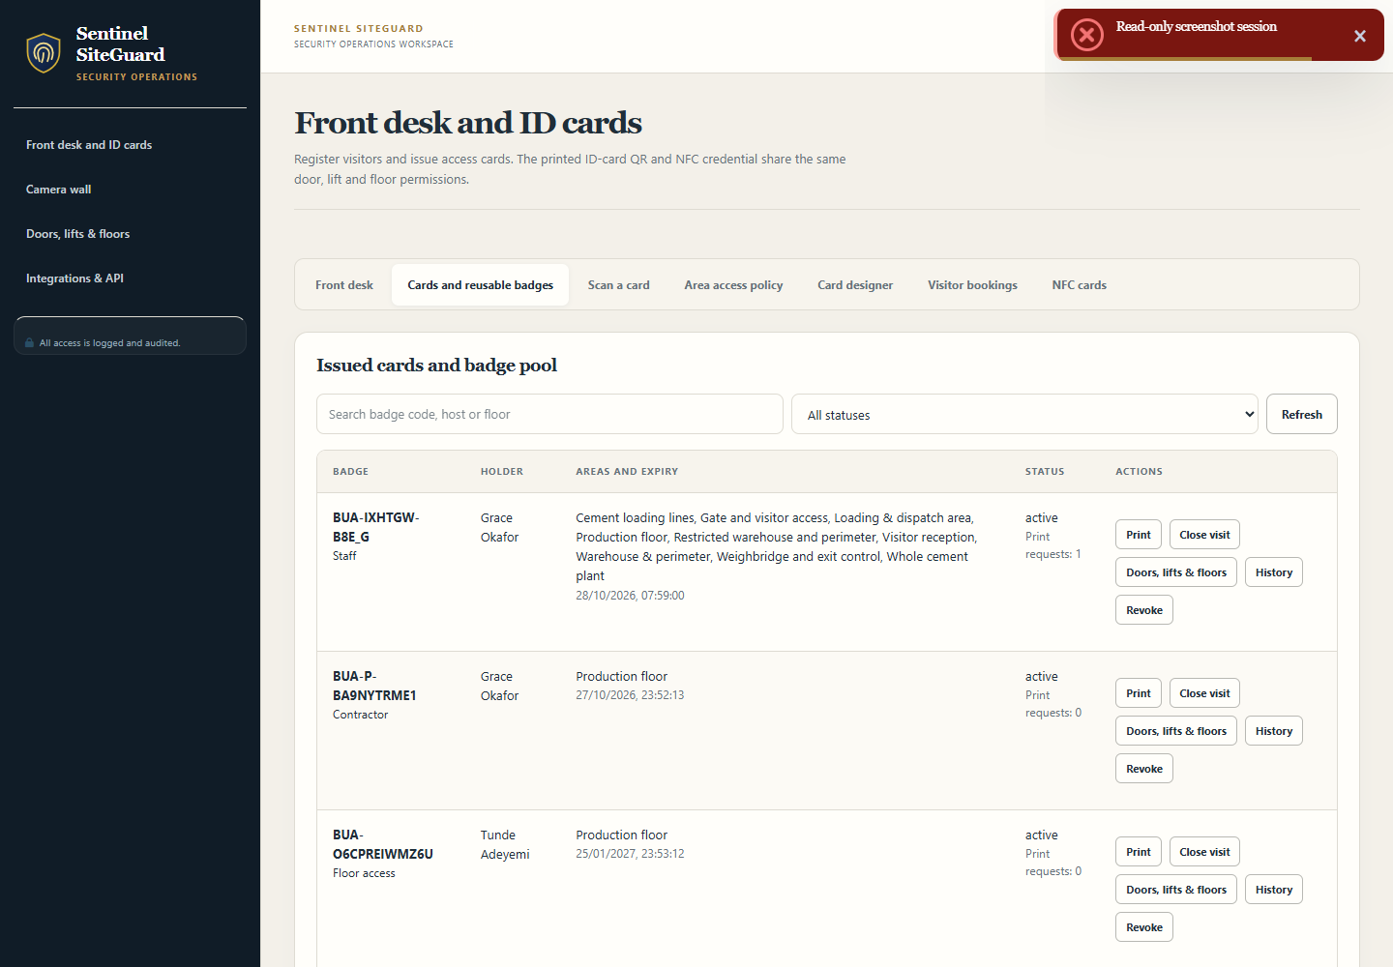
SENTINEL SITEGUARD
Reports and information handling
Reports should retain source context and operating limits.
1
Source-linked camera and detection review.
2
Visitor bookings, badge assignments and rollcall workflows.
3
Collection-permit status and supervisor review context.
Current application interface captured from the configured test system.
Sentinel SiteGuard
14
Notes:
Source: Sentinel SiteGuard current application README, implementation documentation and configured-test-system captures. Generated scenes are illustrative, not customer deployments.
Reports should retain source context and operating limits.
Product outputs
Source-linked camera and detection review.
Visitor bookings, badge assignments and rollcall workflows.
Collection-permit status and supervisor review context.
Timestamped permission decisions with reason, separate from attendance.
Handling responsibilities
Agree who may read, export, share and retain each output. Protect reports and media according to their sensitivity. Review the source records and filters before relying on totals or conclusions.
Visual source: assets/products/screens/siteguard-badges.png
Current application interface captured from the configured test system.

Slide 15

SENTINEL SITEGUARD
Illustrative workflows 1
Examples explain use; they do not claim real customer results.
A visitor may use reception only
Register/check in the visitor and assign a badge.
A lift serves restricted floors
Grant Lift A and Floor 2.
Generated illustrative scenario; not a customer deployment.
Sentinel SiteGuard
15
Notes:
Source: Sentinel SiteGuard current application README, implementation documentation and configured-test-system captures. Generated scenes are illustrative, not customer deployments.
Examples explain use; they do not claim real customer results.
A visitor may use reception only
A visitor has an approved appointment at reception. An ungranted destination remains blocked.
Register/check in the visitor and assign a badge.
Grant the reception door and its floor.
Check the same QR/NFC credential at each requested point.
Conditions: Booking state, card validity, area clearance and point grants must all permit the request.
A lift serves restricted floors
An employee needs Floor 2 but not the executive floor. Lift permission does not enable every floor.
Grant Lift A and Floor 2.
Send the requested destination with the signed credential.
Consume the decision and call the mapped vendor floor command.
Conditions: A commissioned driver and correct controller mappings are required.
Visual source: assets/products/illustrations/resources-scenarios.png
Generated illustrative scenario; not a customer deployment.

Slide 16
SENTINEL SITEGUARD
Illustrative workflows 2
Examples explain use; they do not claim real customer results.
01
02
03
04
Signed QR / NFC
Current assignment
Door / lift / floor grant
Adapter and controller
A returned badge changes hands
A truck arrives for collection
The front desk reuses a physical visitor badge. The previous visitor’s permissions do not carry over.
An operator reviews a vehicle at the loading area. The local permit record supports accountable review.
Sentinel SiteGuard
16
Notes:
Source: Sentinel SiteGuard current application README, implementation documentation and configured-test-system captures. Generated scenes are illustrative, not customer deployments.
Examples explain use; they do not claim real customer results.
A returned badge changes hands
The front desk reuses a physical visitor badge. The previous visitor’s permissions do not carry over.
Close the previous assignment.
Assign the badge to the new visitor.
Grant the new route for the new assignment.
Conditions: The desk must complete return and reassignment; readers must request live decisions.
A truck arrives for collection
An operator reviews a vehicle at the loading area. The local permit record supports accountable review.
Review the plate candidate and permit.
Confirm the truck, driver and paperwork.
Close or revoke the permit after collection.
Conditions: ERP, weighbridge and physical load checks require separate arrangements.

Slide 17
SENTINEL SITEGUARD
Deployment prerequisites
The deployment plan must name the actual infrastructure and inputs.
01
02
03
04
Host and storage
Accounts and network
Permitted inputs
Recovery procedure
Requirements
Capacity and dependencies
Supported Node.js host, MongoDB and protected evidence storage.
Confirm load, data size, retention, input quality, network behavior and backup needs through representative tests.
Sentinel SiteGuard
17
Notes:
Source: Sentinel SiteGuard current application README, implementation documentation and configured-test-system captures. Generated scenes are illustrative, not customer deployments.
The deployment plan must name the actual infrastructure and inputs.
Requirements
Supported Node.js host, MongoDB and protected evidence storage.
Trusted HTTPS and the intended browser/reader devices.
Configured cameras and representative commissioning footage.
Registered areas, buildings, floors, doors and lift destinations.
Manufacturer-supported controller interfaces and commissioned drivers for physical operation.
Capacity and dependencies
Confirm load, data size, retention, input quality, network behavior and backup needs through representative tests. The product overview does not guarantee throughput or availability.

Slide 18
SENTINEL SITEGUARD
Pilot and implementation plan
A proposed sequence to agree with the customer.
01
02
03
04
Discover
Configure
Validate
Hand over
Discovery
Configuration
Pilot
Confirm the intended users, workflows, source systems, integrations and acceptance criteria.
Prepare accounts, permissions, infrastructure and the required inputs.
Exercise normal and failure cases with representative authorised data. Record defects and unresolved dependencies.
Sentinel SiteGuard
18
Notes:
Source: Sentinel SiteGuard current application README, implementation documentation and configured-test-system captures. Generated scenes are illustrative, not customer deployments.
A proposed sequence to agree with the customer.
Discovery
Confirm the intended users, workflows, source systems, integrations and acceptance criteria.
Configuration
Prepare accounts, permissions, infrastructure and the required inputs. Keep any external adapters within the agreed scope.
Pilot
Exercise normal and failure cases with representative authorised data. Record defects and unresolved dependencies.
Handover
Train the responsible staff, review acceptance evidence and agree the support, maintenance and recovery process.

Slide 19
SENTINEL SITEGUARD
Acceptance and validation
Production approval requires evidence from the intended deployment.
01
02
03
04
Representative input
Expected result
Observed result
Human sign-off
Unresolved critical failure → review and retest
Record the expected and actual results before commissioning.
Sentinel SiteGuard
19
Notes:
Source: Sentinel SiteGuard current application README, implementation documentation and configured-test-system captures. Generated scenes are illustrative, not customer deployments.
Production approval requires evidence from the intended deployment.
Acceptance checks
Area permission alone does not permit door or lift access.
A door also requires its enabled floor.
A lift rejects ungranted or unserved floors.
Expired, revoked, returned and reassigned badges cannot reuse old permissions.
Wrong-key, stale and repeated decision consumption fails.
The controller does not operate after a denied or ambiguous response.
ID-card QR and NFC produce the same current-assignment outcome.
Sign-off record
For each check retain the owner, date, test inputs, expected result and observed result. Resolve critical failures before treating the workflow as commissioned.

Slide 20
SENTINEL SITEGUARD
Training and handover
Training should follow the roles that will use the installed product.
01
02
03
04
Administrators
Daily operators
Technical owners
Handover evidence
Administration
Daily operation
Technical handover
Accounts, permissions, source/device configuration and ongoing access reviews.
The product workflow, source review, exception handling and escalation.
Integration responsibilities, protected credentials, backup/restore and host monitoring.
Sentinel SiteGuard
20
Notes:
Source: Sentinel SiteGuard current application README, implementation documentation and configured-test-system captures. Generated scenes are illustrative, not customer deployments.
Training should follow the roles that will use the installed product.
Administration
Accounts, permissions, source/device configuration and ongoing access reviews.
Daily operation
The product workflow, source review, exception handling and escalation.
Technical handover
Integration responsibilities, protected credentials, backup/restore and host monitoring.
Completion evidence
Record attendance, operating procedures, responsible contacts and any remaining configuration requirements.

Slide 21
SENTINEL SITEGUARD
Operations and support
Maintain the installation and the human review process.
01
02
03
04
Review access
Maintain sources
Protect backups
Test recovery
Operational checklist
Support agreement
Review card grants, point mappings and visitor checkout.
Agree working hours, response targets, escalation contacts, defect/change handling, update responsibilities and any…
Sentinel SiteGuard
21
Notes:
Source: Sentinel SiteGuard current application README, implementation documentation and configured-test-system captures. Generated scenes are illustrative, not customer deployments.
Maintain the installation and the human review process.
Operational checklist
Review card grants, point mappings and visitor checkout.
Monitor camera health, alert delivery and storage.
Rotate keys and test network/device restrictions.
Exercise controller failures, emergency procedures and recovery with the responsible specialists.
Support agreement
Agree working hours, response targets, escalation contacts, defect/change handling, update responsibilities and any on-site requirements in the commercial agreement. No service-level guarantee is made here.

Slide 22
SENTINEL SITEGUARD
Commercial scope
A product-specific written quotation defines the offer.
Agree what is included.
List what needs a separate provision.
Software and deployment
Integration and hardware
State the product, permitted deployment, user/usage scope and installation responsibilities.
List each included source, device, adapter, third-party licence and specialist service.
Training and support
Costs and changes
Specify training sessions, handover deliverables, support coverage and renewal arrangements.
Confirm currency, taxes, payment milestones, travel and infrastructure costs in the quotation.
Sentinel SiteGuard
22
Notes:
Source: Sentinel SiteGuard current application README, implementation documentation and configured-test-system captures. Generated scenes are illustrative, not customer deployments.
A product-specific written quotation defines the offer.
Software and deployment
State the product, permitted deployment, user/usage scope and installation responsibilities.
Integration and hardware
List each included source, device, adapter, third-party licence and specialist service. Identify customer-provided hardware and excluded work.
Training and support
Specify training sessions, handover deliverables, support coverage and renewal arrangements.
Costs and changes
Confirm currency, taxes, payment milestones, travel and infrastructure costs in the quotation. New requirements need written change approval.

Slide 23
SENTINEL SITEGUARD
Questions and scope boundaries
The product remains separate from the other portfolio applications.
Can one ID card work at doors and lifts?
Does every controller work automatically?
Yes, with explicit permissions for its current assignment. QR and NFC share those permissions.
No. A manufacturer-supported API, SDK or gateway and commissioning are required.
Can a raw NFC UID open a door?
Does a successful check unlock hardware?
The built-in flow uses signed QR/NDEF text. Other secure-card protocols require explicit integration.
A trusted adapter must consume the decision and call the configured mapped driver.
Sentinel SiteGuard
23
Notes:
Source: Sentinel SiteGuard current application README, implementation documentation and configured-test-system captures. Generated scenes are illustrative, not customer deployments.
The product remains separate from the other portfolio applications.
Can one ID card work at doors and lifts?
Yes, with explicit permissions for its current assignment. QR and NFC share those permissions.
Does every controller work automatically?
No. A manufacturer-supported API, SDK or gateway and commissioning are required.
Can a raw NFC UID open a door?
The built-in flow uses signed QR/NDEF text. Other secure-card protocols require explicit integration.
Does a successful check unlock hardware?
A trusted adapter must consume the decision and call the configured mapped driver.
Does decision history prove attendance?
No. Physical confirmation needs controller contacts or other authorised telemetry.
Are permits an ERP integration?
The permit register supports supervisor review. ERP, weighbridge and load validation require separate work.

Slide 24
SENTINEL SITEGUARD
See it in your
workflow.
Demonstrate the task. Review the inputs. Agree the scope.
A separate discussion for Sentinel SiteGuard
Generated concept illustration
Notes:
Source: Sentinel SiteGuard current application README, implementation documentation and configured-test-system captures. Generated scenes are illustrative, not customer deployments.
A focused discussion before implementation.
Demonstration
Review Sentinel SiteGuard using your intended workflow and representative authorised inputs.
Scope workshop
Agree the users, infrastructure, sources, integrations and operating responsibilities.
Written proposal
Confirm deliverables, acceptance evidence, exclusions, training and commercial terms.
Source basis
Product descriptions reflect the local Sentinel SiteGuard application README and relevant implementation documentation reviewed on 31 October 2026. Optional services and model/hardware performance require validation.
Enquiries
Use the website support form and select Sentinel SiteGuard for a demonstration or quotation.

