Slide 1


VISUAL PRODUCT PRESENTATION
Sentinel SkyWatch
Drone camera surveillance, aircraft records and a separate flight practice lab.
Current screens · Visual workflows · Deployment detail
Generated concept illustration
Notes:
Source: Sentinel SkyWatch current application README, implementation documentation and configured-test-system captures. Generated scenes are illustrative, not customer deployments.
Drone camera surveillance, aircraft records and a separate flight practice lab.
Product proposal
Prepared for organisations assessing Sentinel SkyWatch. This is a product overview and proposed implementation approach, not a signed offer or statement of completed deployment.
Edition
31 October 2026
Product scope
Sentinel SkyWatch does not fly a real aircraft. Operators use the aircraft’s own controller. The practice lab is a simulation; its detections and flight telemetry are training data.
Visual source: assets/products/skywatch-hero.png
Generated concept illustration.

Slide 2

SENTINEL SKYWATCH
Executive overview
A drone fleet workspace for camera feeds, surveillance review, site alerts and flight practice.
The operational outcome
Organised aircraft, camera observations and mission records.
Who uses it
Drone operators, surveillance teams and training leads
Generated illustrative scenario; not a customer deployment.
Sentinel SkyWatch
02
Notes:
Source: Sentinel SkyWatch current application README, implementation documentation and configured-test-system captures. Generated scenes are illustrative, not customer deployments.
A drone fleet workspace for camera feeds, surveillance review, site alerts and flight practice.
Intended team
Drone operators, surveillance teams and training leads
Operational outcome
Organised aircraft, camera observations and mission records.
Implementation boundary
Drone camera surveillance, aircraft records and a separate flight practice lab. Requirements depend on the chosen host, inputs, permissions and agreed integration scope.
Decision context
The organisation retains responsibility for authorised use, staff decisions, source data and commissioning. Illustrative scenarios are examples, not customer testimonials.
Visual source: assets/products/illustrations/products-scenarios.png
Generated illustrative scenario; not a customer deployment.

Slide 3

SENTINEL SKYWATCH
Users and responsibilities
Clear ownership supports accountable operation.
Administrator
Manage accounts, sites, registered aircraft and application security policy.
Assigned operator
Maintain mission status and review the camera input while flying with the aircraft controller.
Surveillance reviewer
Examine authorised feeds, alerts and captured observations.
Training lead
Use simulated practice missions to develop operator familiarity.
Generated illustrative scenario; not a customer deployment.
Sentinel SkyWatch
03
Notes:
Source: Sentinel SkyWatch current application README, implementation documentation and configured-test-system captures. Generated scenes are illustrative, not customer deployments.
Clear ownership supports accountable operation.
Administrator
Manage accounts, sites, registered aircraft and application security policy.
Assigned operator
Maintain mission status and review the camera input while flying with the aircraft controller.
Surveillance reviewer
Examine authorised feeds, alerts and captured observations.
Training lead
Use simulated practice missions to develop operator familiarity.
Visual source: assets/products/illustrations/about-scenarios.png
Generated illustrative scenario; not a customer deployment.

Slide 4
SENTINEL SKYWATCH
Operational workflow
The product follows its own recorded workflow.
01
02
03
04
Prepare the aircraft
Connect supported video
Review observations
Record and debrief
Stage 1
Stage 2
Stage 3
Register the aircraft and connect the video input carrying its camera feed.
Fly using the aircraft’s own controller while reviewing the feed and configured alerts.
Capture observations, review reports and use the separate practice lab for training.
Sentinel SkyWatch
04
Notes:
Source: Sentinel SkyWatch current application README, implementation documentation and configured-test-system captures. Generated scenes are illustrative, not customer deployments.
The product follows its own recorded workflow.
Stage 1
Register the aircraft and connect the video input carrying its camera feed.
Stage 2
Fly using the aircraft’s own controller while reviewing the feed and configured alerts.
Stage 3
Capture observations, review reports and use the separate practice lab for training.

Slide 5
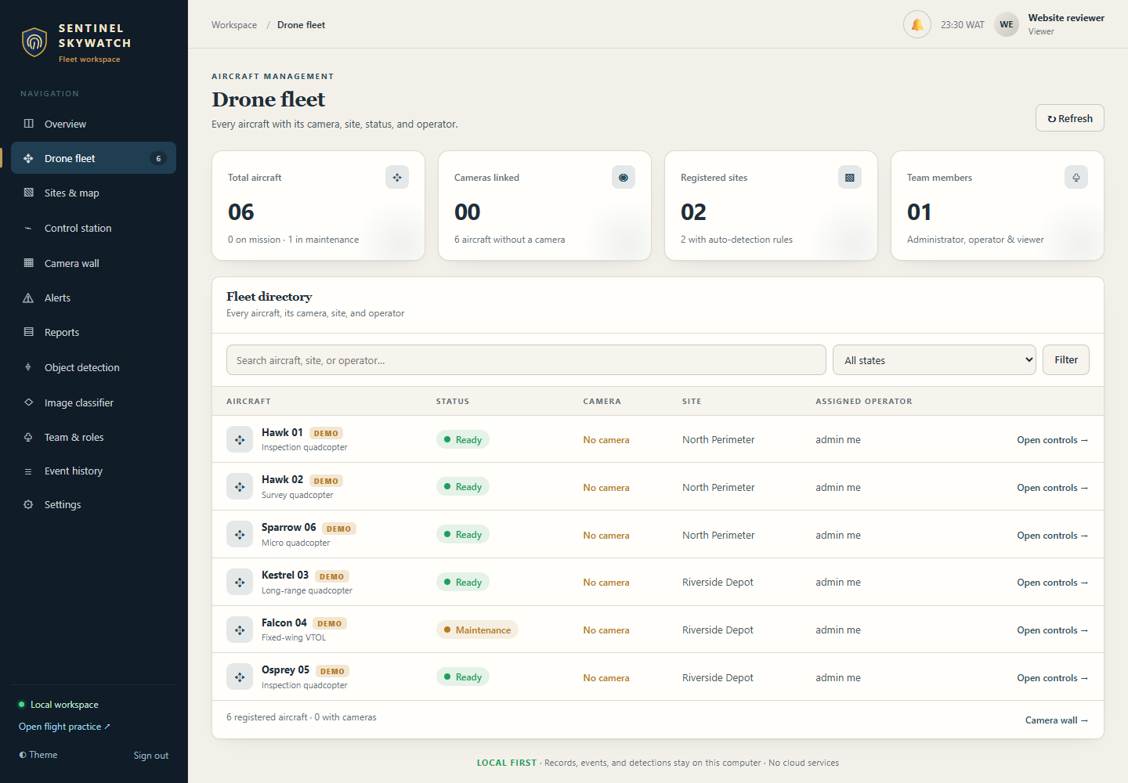
SENTINEL SKYWATCH
Aircraft and site register
Register aircraft, assign operators and link camera inputs to sites. Ready, On mission and Maintenance reflect recorded operational status.
1
Link each aircraft to its intended input.
2
Maintain operator and site assignments.
3
Keep recorded status current.
Current application interface captured from the configured test system.
Sentinel SkyWatch
05
Notes:
Source: Sentinel SkyWatch current application README, implementation documentation and configured-test-system captures. Generated scenes are illustrative, not customer deployments.
Register aircraft, assign operators and link camera inputs to sites. Ready, On mission and Maintenance reflect recorded operational status.
Operating approach
These records organise responsibility. The application does not send flight commands or replace the aircraft manufacturer’s controller.
What the team reviews
Link each aircraft to its intended input.
Maintain operator and site assignments.
Keep recorded status current.
Acceptance evidence
Demonstrate this workflow using representative permitted inputs. Record the expected result, actual result, responsible reviewer and any remaining conditions before production approval.
Visual source: assets/products/screens/skywatch-aircraft.png
Current application interface captured from the configured test system.

Slide 6
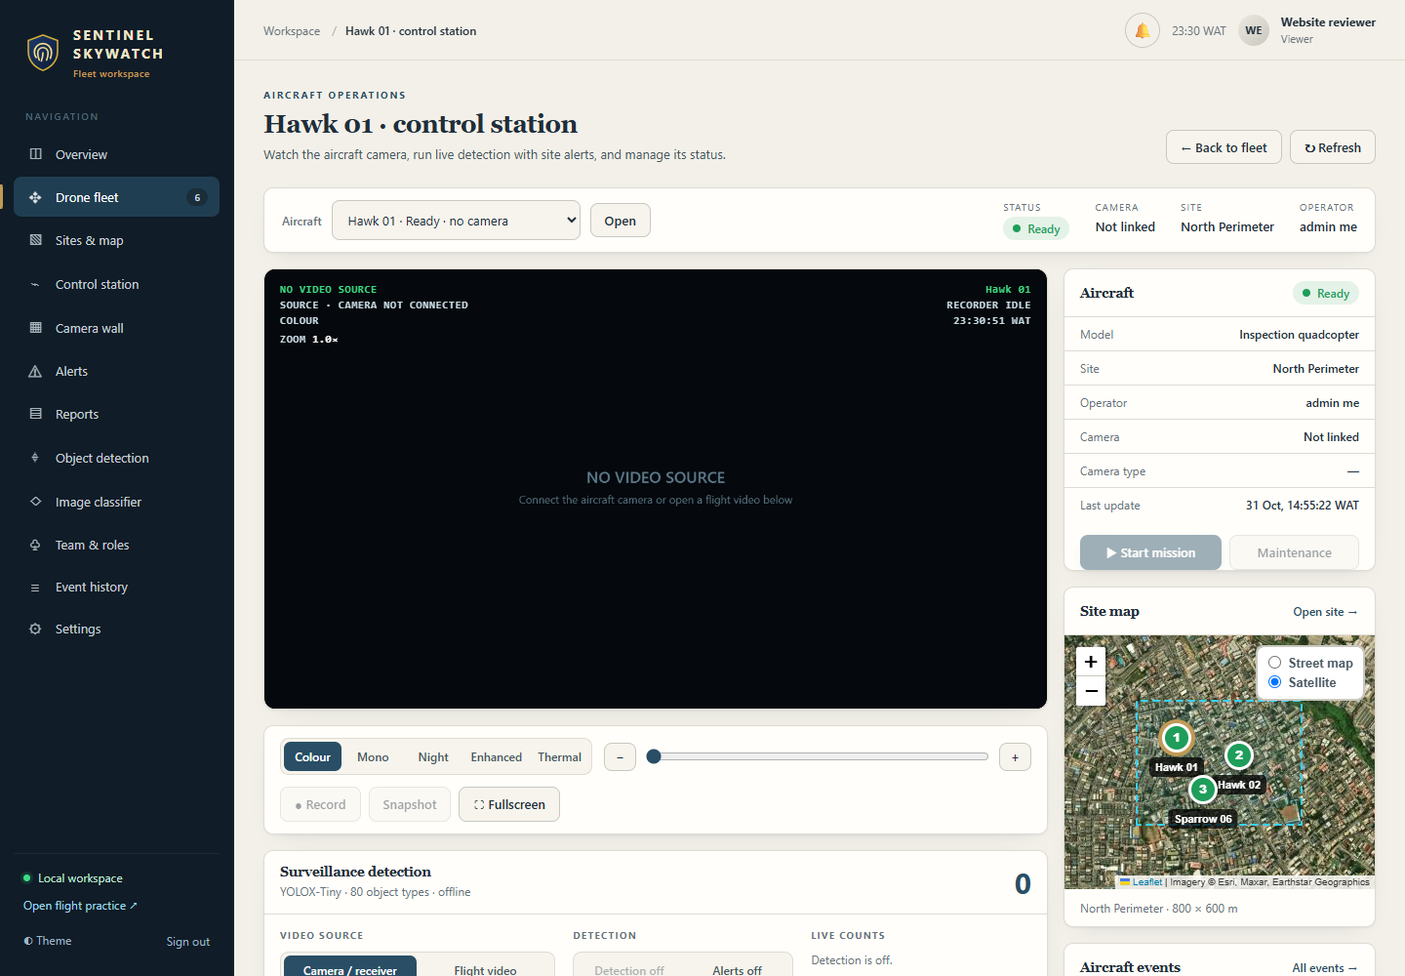
SENTINEL SKYWATCH
Camera control station
Review supported video inputs or recorded flight video, select viewing modes and capture snapshots or recordings.
1
Confirm the intended camera source.
2
Review the original frame with annotations.
3
Protect captured observations.
Current interface; source connections are inactive in this test capture.
Sentinel SkyWatch
06
Notes:
Source: Sentinel SkyWatch current application README, implementation documentation and configured-test-system captures. Generated scenes are illustrative, not customer deployments.
Review supported video inputs or recorded flight video, select viewing modes and capture snapshots or recordings.
Operating approach
Arrange the video connection from the aircraft controller to the operator computer separately. Verify browser permissions, input quality and practical latency.
What the team reviews
Confirm the intended camera source.
Review the original frame with annotations.
Protect captured observations.
Acceptance evidence
Demonstrate this workflow using representative permitted inputs. Record the expected result, actual result, responsible reviewer and any remaining conditions before production approval.
Visual source: assets/products/screens/skywatch-control-station.png
Current interface; source connections are inactive in this test capture.

Slide 7
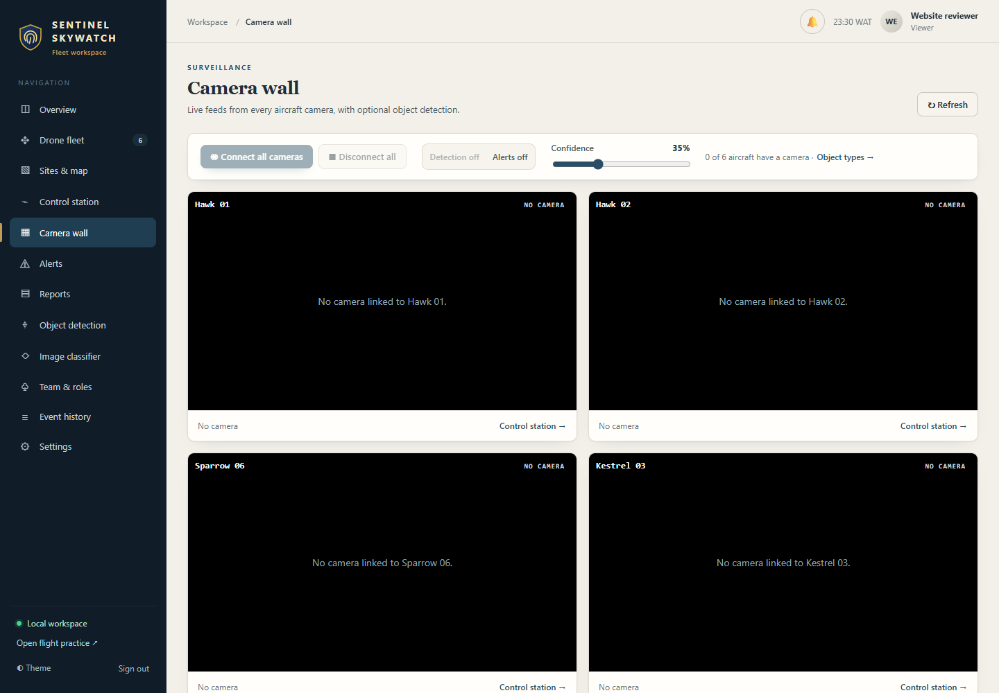
SENTINEL SKYWATCH
Site alerts and camera wall
Review several feeds and configure the supported detection categories, confidence, counts and site alert behavior.
1
Choose relevant categories and thresholds.
2
Test repeat intervals and notification delivery.
3
Keep an operator responsible for response.
Current interface; source connections are inactive in this test capture.
Sentinel SkyWatch
07
Notes:
Source: Sentinel SkyWatch current application README, implementation documentation and configured-test-system captures. Generated scenes are illustrative, not customer deployments.
Review several feeds and configure the supported detection categories, confidence, counts and site alert behavior.
Operating approach
Available labels, image quality and compute resources affect performance. Operators should validate rules with representative footage rather than treating a detection as a final conclusion.
What the team reviews
Choose relevant categories and thresholds.
Test repeat intervals and notification delivery.
Keep an operator responsible for response.
Acceptance evidence
Demonstrate this workflow using representative permitted inputs. Record the expected result, actual result, responsible reviewer and any remaining conditions before production approval.
Visual source: assets/products/screens/skywatch-camera-wall.png
Current interface; source connections are inactive in this test capture.

Slide 8
SENTINEL SKYWATCH
Thermal and enhanced viewing
The station offers enhanced modes and thermal palettes for suitable camera inputs.
Visible-light palette
Thermal camera input
Visual enhancement only
Calibration and scale required
A display effect is not a calibrated temperature measurement.
Sentinel SkyWatch
08
Notes:
Source: Sentinel SkyWatch current application README, implementation documentation and configured-test-system captures. Generated scenes are illustrative, not customer deployments.
The station offers enhanced modes and thermal palettes for suitable camera inputs.
Operating approach
True heat interpretation needs a thermal camera and appropriate calibration. A visible-light brightness palette is pseudo-thermal and does not measure temperature.
What the team reviews
Distinguish camera hardware from view mode.
Record scale/calibration assumptions.
Review hot-spots against the original input.
Acceptance evidence
Demonstrate this workflow using representative permitted inputs. Record the expected result, actual result, responsible reviewer and any remaining conditions before production approval.

Slide 9
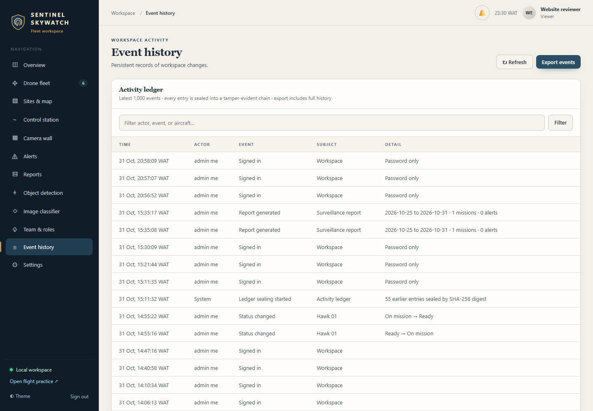
SENTINEL SKYWATCH
Mission records and captures
Recorded mission status, alerts and detection activity support incident and mission reports. Operators can save reviewed snapshots and recordings.
1
Choose the relevant reporting period.
2
Review pilot and incident context.
3
Protect stored media and exports.
Current application interface captured from the configured test system.
Sentinel SkyWatch
09
Notes:
Source: Sentinel SkyWatch current application README, implementation documentation and configured-test-system captures. Generated scenes are illustrative, not customer deployments.
Recorded mission status, alerts and detection activity support incident and mission reports. Operators can save reviewed snapshots and recordings.
Operating approach
The software’s records are distinct from aircraft flight-recorder telemetry. The deployment plan should define evidence handling and report review.
What the team reviews
Choose the relevant reporting period.
Review pilot and incident context.
Protect stored media and exports.
Acceptance evidence
Demonstrate this workflow using representative permitted inputs. Record the expected result, actual result, responsible reviewer and any remaining conditions before production approval.
Visual source: assets/products/screens/skywatch-events.png
Current application interface captured from the configured test system.

Slide 10
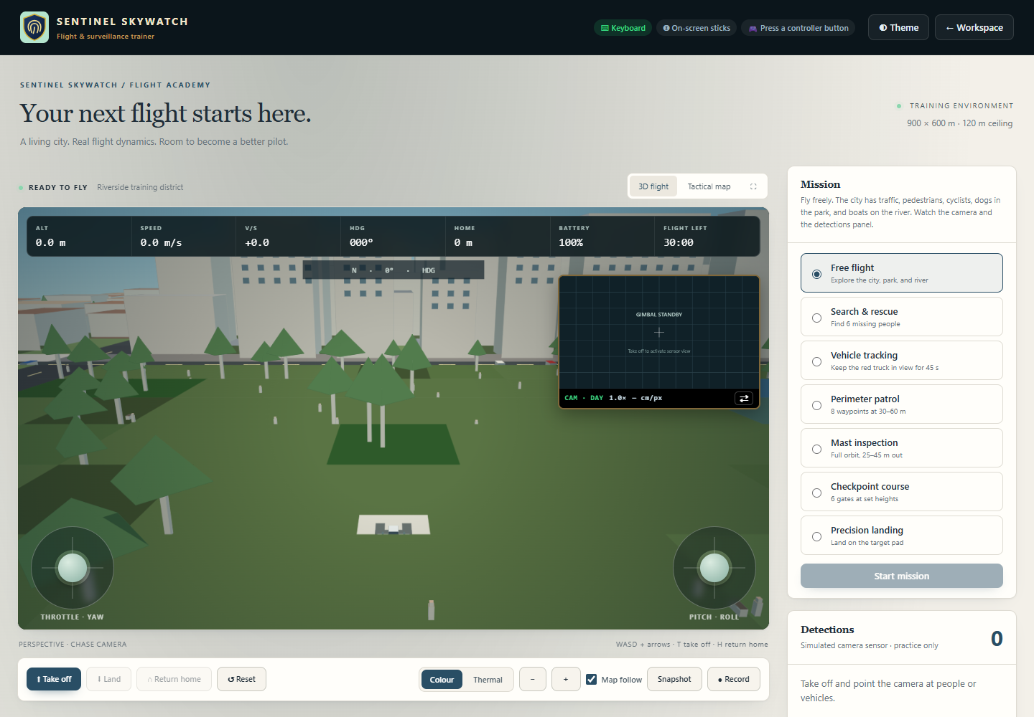
SENTINEL SKYWATCH
Flight practice lab
A separate procedural 3D city supports keyboard, on-screen sticks and compatible controllers, with a tactical map and sensor view.
1
Practise landing and return home.
2
Use simulated surveillance missions.
3
Validate physical controller mappings.
Current simulated practice interface.
Sentinel SkyWatch
10
Notes:
Source: Sentinel SkyWatch current application README, implementation documentation and configured-test-system captures. Generated scenes are illustrative, not customer deployments.
A separate procedural 3D city supports keyboard, on-screen sticks and compatible controllers, with a tactical map and sensor view.
Operating approach
Practice missions use simulated flight and detection data. They remain separate from live aircraft operations and do not establish flightworthiness or certification.
What the team reviews
Practise landing and return home.
Use simulated surveillance missions.
Validate physical controller mappings.
Acceptance evidence
Demonstrate this workflow using representative permitted inputs. Record the expected result, actual result, responsible reviewer and any remaining conditions before production approval.
Visual source: assets/products/screens/skywatch-practice.png
Current simulated practice interface.

Slide 11
SENTINEL SKYWATCH
Architecture and information flow
Components and responsibilities for this product.
01
02
03
04
Aircraft and controller
Camera capture input
SkyWatch workspace
Recorded observations
The practice lab is a separate simulated training environment.
Sentinel SkyWatch
11
Notes:
Source: Sentinel SkyWatch current application README, implementation documentation and configured-test-system captures. Generated scenes are illustrative, not customer deployments.
Components and responsibilities for this product.
Aircraft and controller
The operator flies using the manufacturer’s own equipment.
Video connection
A supported capture device or receiver exposes the feed as a camera input.
Sentinel SkyWatch workspace
The local browser/application organise cameras, aircraft, rules and observations.
Data and training
Configured local storage holds records/media; the separate practice lab simulates flying.

Slide 12
SENTINEL SKYWATCH
Integrations and commissioning
Each connection requires authorised configuration.
Controller video output
Visible / thermal camera
Commission
and validate
Sentinel SkyWatch
Site alerts
Maps and place search
Every source, device or service has its own setup and validation requirements.
Practice controllers
Sentinel SkyWatch
12
Notes:
Source: Sentinel SkyWatch current application README, implementation documentation and configured-test-system captures. Generated scenes are illustrative, not customer deployments.
Each connection requires authorised configuration.
Controller video output
Compatible receiver or capture device exposing a supported input. This is video review, not aircraft command/control integration.
Visible / thermal camera
Appropriate hardware and camera type selection. Thermal interpretation requires real thermal input and calibration.
Site alerts
Configured categories, thresholds and notification permissions. Test sound and desktop notification delivery.
Maps and place search
Configured external imagery and search providers. These need their network services; the practice city is procedural.
Practice controllers
Compatible browser gamepad, on-screen sticks or keyboard. Test mappings, dead zones and disconnect behavior.

Slide 13
SENTINEL SKYWATCH
Security and access boundaries
Security depends on the product controls and the operating environment.
1
Authorised account
The operator uses the aircraft controller. The workspace and practice lab do not command live flight.
2
Product permissions
3
Human review
4
Protected export / recovery
Sentinel SkyWatch
13
Notes:
Source: Sentinel SkyWatch current application README, implementation documentation and configured-test-system captures. Generated scenes are illustrative, not customer deployments.
Security depends on the product controls and the operating environment.
Local default
The server defaults to loopback on the operator computer.
Account and roles
Account and assignment permissions govern application actions.
Session security
Authenticator and configured inactivity/absolute limits support account protection.
Network access
Shared access uses trusted HTTPS with configured certificates and permitted hosts.
Storage and activity
A sealed ledger supports integrity checks; protect data and backups with host access and disk encryption.

Slide 14
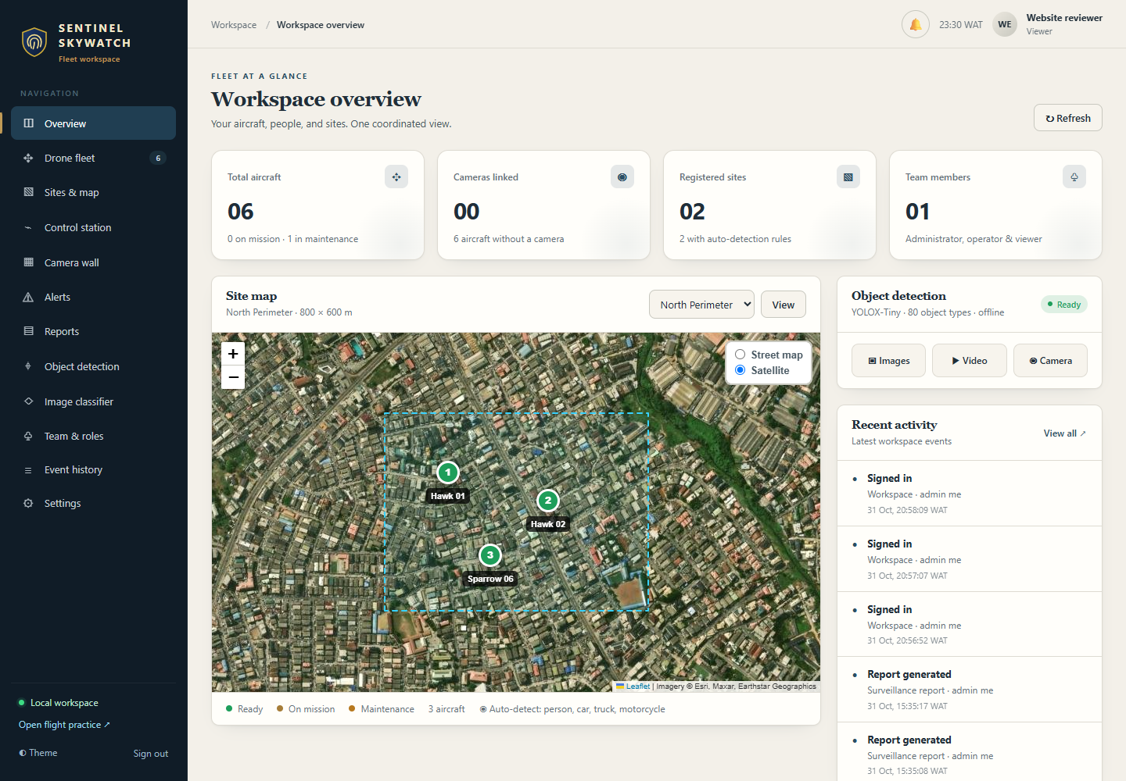
SENTINEL SKYWATCH
Reports and information handling
Reports should retain source context and operating limits.
1
Recorded missions and incidents for a reporting period.
2
Site alert acknowledgements and detection activity.
3
Captured snapshots and video observations.
Current application interface captured from the configured test system.
Sentinel SkyWatch
14
Notes:
Source: Sentinel SkyWatch current application README, implementation documentation and configured-test-system captures. Generated scenes are illustrative, not customer deployments.
Reports should retain source context and operating limits.
Product outputs
Recorded missions and incidents for a reporting period.
Site alert acknowledgements and detection activity.
Captured snapshots and video observations.
Ledger integrity checks and printed/PDF report outputs.
Handling responsibilities
Agree who may read, export, share and retain each output. Protect reports and media according to their sensitivity. Review the source records and filters before relying on totals or conclusions.
Visual source: assets/products/screens/skywatch-overview.png
Current application interface captured from the configured test system.

Slide 15

SENTINEL SKYWATCH
Illustrative workflows 1
Examples explain use; they do not claim real customer results.
A perimeter flight needs a record
Select the aircraft and confirm its camera input.
A thermal input supports night review
Confirm the camera type and scale assumptions.
Generated illustrative scenario; not a customer deployment.
Sentinel SkyWatch
15
Notes:
Source: Sentinel SkyWatch current application README, implementation documentation and configured-test-system captures. Generated scenes are illustrative, not customer deployments.
Examples explain use; they do not claim real customer results.
A perimeter flight needs a record
An operator surveys an authorised site. Aircraft responsibility and camera events remain organised.
Select the aircraft and confirm its camera input.
Review relevant detections and site alerts.
Save observations and review the mission report.
Conditions: The operator flies independently using the aircraft controller.
A thermal input supports night review
The aircraft provides genuine thermal video. Viewing tools retain the limits of the input.
Confirm the camera type and scale assumptions.
Review hot-spots and palette views.
Compare the observation with the original feed.
Conditions: Visible-light pseudo-thermal cannot establish measured temperature.
Visual source: assets/products/illustrations/resources-scenarios.png
Generated illustrative scenario; not a customer deployment.

Slide 16
SENTINEL SKYWATCH
Illustrative workflows 2
Examples explain use; they do not claim real customer results.
01
02
03
04
Operator flies aircraft
Camera input to workspace
Human review of captures
Mission record
Several aircraft feeds need monitoring
An operator practises landing
A team reviews multiple authorised inputs. The team can follow responsibility across the inputs.
A training lead selects the separate practice lab.
Sentinel SkyWatch
16
Notes:
Source: Sentinel SkyWatch current application README, implementation documentation and configured-test-system captures. Generated scenes are illustrative, not customer deployments.
Examples explain use; they do not claim real customer results.
Several aircraft feeds need monitoring
A team reviews multiple authorised inputs. The team can follow responsibility across the inputs.
Link each input to the intended aircraft.
Connect the wall and review events.
Maintain mission status and operator assignments.
Conditions: Capture channels, browser support and computer capacity must be tested.
An operator practises landing
A training lead selects the separate practice lab. Operators can practise the application workflow without a real aircraft.
Choose the mission and input method.
Fly in the simulated world using its sensor view.
Review the exercise and repeat with suitable settings.
Conditions: Practice does not certify the operator for live flight.

Slide 17
SENTINEL SKYWATCH
Deployment prerequisites
The deployment plan must name the actual infrastructure and inputs.
01
02
03
04
Host and storage
Accounts and network
Permitted inputs
Recovery procedure
Requirements
Capacity and dependencies
Supported Node.js host and protected local data storage.
Confirm load, data size, retention, input quality, network behavior and backup needs through representative tests.
Sentinel SkyWatch
17
Notes:
Source: Sentinel SkyWatch current application README, implementation documentation and configured-test-system captures. Generated scenes are illustrative, not customer deployments.
The deployment plan must name the actual infrastructure and inputs.
Requirements
Supported Node.js host and protected local data storage.
Compatible camera/capture hardware for each intended feed.
Manufacturer flight controller, approved procedures and trained operators.
Network services for maps and place search where used.
Trusted HTTPS and certificates for access from other devices.
Capacity and dependencies
Confirm load, data size, retention, input quality, network behavior and backup needs through representative tests. The product overview does not guarantee throughput or availability.

Slide 18
SENTINEL SKYWATCH
Pilot and implementation plan
A proposed sequence to agree with the customer.
01
02
03
04
Discover
Configure
Validate
Hand over
Discovery
Configuration
Pilot
Confirm the intended users, workflows, source systems, integrations and acceptance criteria.
Prepare accounts, permissions, infrastructure and the required inputs.
Exercise normal and failure cases with representative authorised data. Record defects and unresolved dependencies.
Sentinel SkyWatch
18
Notes:
Source: Sentinel SkyWatch current application README, implementation documentation and configured-test-system captures. Generated scenes are illustrative, not customer deployments.
A proposed sequence to agree with the customer.
Discovery
Confirm the intended users, workflows, source systems, integrations and acceptance criteria.
Configuration
Prepare accounts, permissions, infrastructure and the required inputs. Keep any external adapters within the agreed scope.
Pilot
Exercise normal and failure cases with representative authorised data. Record defects and unresolved dependencies.
Handover
Train the responsible staff, review acceptance evidence and agree the support, maintenance and recovery process.

Slide 19
SENTINEL SKYWATCH
Acceptance and validation
Production approval requires evidence from the intended deployment.
01
02
03
04
Representative input
Expected result
Observed result
Human sign-off
Unresolved critical failure → review and retest
Record the expected and actual results before commissioning.
Sentinel SkyWatch
19
Notes:
Source: Sentinel SkyWatch current application README, implementation documentation and configured-test-system captures. Generated scenes are illustrative, not customer deployments.
Production approval requires evidence from the intended deployment.
Acceptance checks
The intended aircraft input opens with usable quality and latency.
Site rules create expected reviewed alerts on representative footage.
True thermal and pseudo-thermal views remain correctly identified.
Status changes and captures appear in reports/storage.
Unauthorised roles cannot change protected configuration.
Practice landing, return-home and controller inputs pass the intended exercises.
Backup, HTTPS and ledger checks succeed.
Sign-off record
For each check retain the owner, date, test inputs, expected result and observed result. Resolve critical failures before treating the workflow as commissioned.

Slide 20
SENTINEL SKYWATCH
Training and handover
Training should follow the roles that will use the installed product.
01
02
03
04
Administrators
Daily operators
Technical owners
Handover evidence
Administration
Daily operation
Technical handover
Accounts, permissions, source/device configuration and ongoing access reviews.
The product workflow, source review, exception handling and escalation.
Integration responsibilities, protected credentials, backup/restore and host monitoring.
Sentinel SkyWatch
20
Notes:
Source: Sentinel SkyWatch current application README, implementation documentation and configured-test-system captures. Generated scenes are illustrative, not customer deployments.
Training should follow the roles that will use the installed product.
Administration
Accounts, permissions, source/device configuration and ongoing access reviews.
Daily operation
The product workflow, source review, exception handling and escalation.
Technical handover
Integration responsibilities, protected credentials, backup/restore and host monitoring.
Completion evidence
Record attendance, operating procedures, responsible contacts and any remaining configuration requirements.

Slide 21
SENTINEL SKYWATCH
Operations and support
Maintain the installation and the human review process.
01
02
03
04
Review access
Maintain sources
Protect backups
Test recovery
Operational checklist
Support agreement
Review assignments and linked video sources.
Agree working hours, response targets, escalation contacts, defect/change handling, update responsibilities and any…
Sentinel SkyWatch
21
Notes:
Source: Sentinel SkyWatch current application README, implementation documentation and configured-test-system captures. Generated scenes are illustrative, not customer deployments.
Maintain the installation and the human review process.
Operational checklist
Review assignments and linked video sources.
Monitor capture stability, alerts and storage growth.
Back up data and retain independent audit-head records where required.
Maintain certificates and retest changed capture/controller hardware.
Support agreement
Agree working hours, response targets, escalation contacts, defect/change handling, update responsibilities and any on-site requirements in the commercial agreement. No service-level guarantee is made here.

Slide 22
SENTINEL SKYWATCH
Commercial scope
A product-specific written quotation defines the offer.
Agree what is included.
List what needs a separate provision.
Software and deployment
Integration and hardware
State the product, permitted deployment, user/usage scope and installation responsibilities.
List each included source, device, adapter, third-party licence and specialist service.
Training and support
Costs and changes
Specify training sessions, handover deliverables, support coverage and renewal arrangements.
Confirm currency, taxes, payment milestones, travel and infrastructure costs in the quotation.
Sentinel SkyWatch
22
Notes:
Source: Sentinel SkyWatch current application README, implementation documentation and configured-test-system captures. Generated scenes are illustrative, not customer deployments.
A product-specific written quotation defines the offer.
Software and deployment
State the product, permitted deployment, user/usage scope and installation responsibilities.
Integration and hardware
List each included source, device, adapter, third-party licence and specialist service. Identify customer-provided hardware and excluded work.
Training and support
Specify training sessions, handover deliverables, support coverage and renewal arrangements.
Costs and changes
Confirm currency, taxes, payment milestones, travel and infrastructure costs in the quotation. New requirements need written change approval.

Slide 23
SENTINEL SKYWATCH
Questions and scope boundaries
The product remains separate from the other portfolio applications.
Does Sentinel SkyWatch fly the aircraft?
Is the practice lab a live-flight system?
No. The operator uses the aircraft’s own controller; Sentinel SkyWatch reviews video and organises observations.
No. The city, flight telemetry and detection sensor are simulated.
Can any camera measure heat?
How many simultaneous feeds are guaranteed?
No. Heat interpretation requires thermal hardware and calibration.
The supported deployment count depends on capture hardware, browser support and measured computer capacity.
Sentinel SkyWatch
23
Notes:
Source: Sentinel SkyWatch current application README, implementation documentation and configured-test-system captures. Generated scenes are illustrative, not customer deployments.
The product remains separate from the other portfolio applications.
Does Sentinel SkyWatch fly the aircraft?
No. The operator uses the aircraft’s own controller; Sentinel SkyWatch reviews video and organises observations.
Is the practice lab a live-flight system?
No. The city, flight telemetry and detection sensor are simulated.
Can any camera measure heat?
No. Heat interpretation requires thermal hardware and calibration.
How many simultaneous feeds are guaranteed?
The supported deployment count depends on capture hardware, browser support and measured computer capacity.
Can everything operate without internet?
Local features can run locally; maps, search and initial provisioning may need network services.
What does a quote include?
The agreed software deployment, capture arrangements, training and support. Aircraft and specialist hardware need an explicit commercial scope.

Slide 24
SENTINEL SKYWATCH
See it in your
workflow.
Demonstrate the task. Review the inputs. Agree the scope.
A separate discussion for Sentinel SkyWatch
Generated concept illustration
Notes:
Source: Sentinel SkyWatch current application README, implementation documentation and configured-test-system captures. Generated scenes are illustrative, not customer deployments.
A focused discussion before implementation.
Demonstration
Review Sentinel SkyWatch using your intended workflow and representative authorised inputs.
Scope workshop
Agree the users, infrastructure, sources, integrations and operating responsibilities.
Written proposal
Confirm deliverables, acceptance evidence, exclusions, training and commercial terms.
Source basis
Product descriptions reflect the local Sentinel SkyWatch application README and relevant implementation documentation reviewed on 31 October 2026. Optional services and model/hardware performance require validation.
Enquiries
Use the website support form and select Sentinel SkyWatch for a demonstration or quotation.

